Slide 1


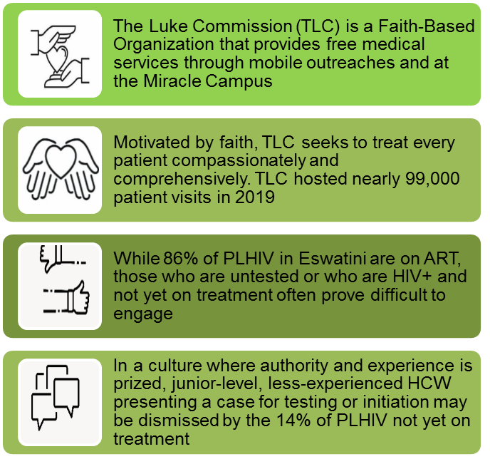
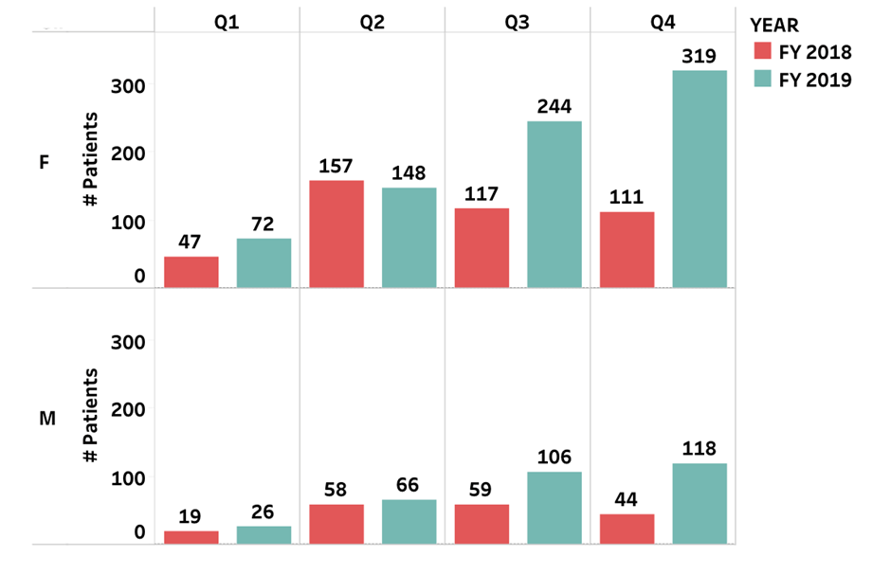
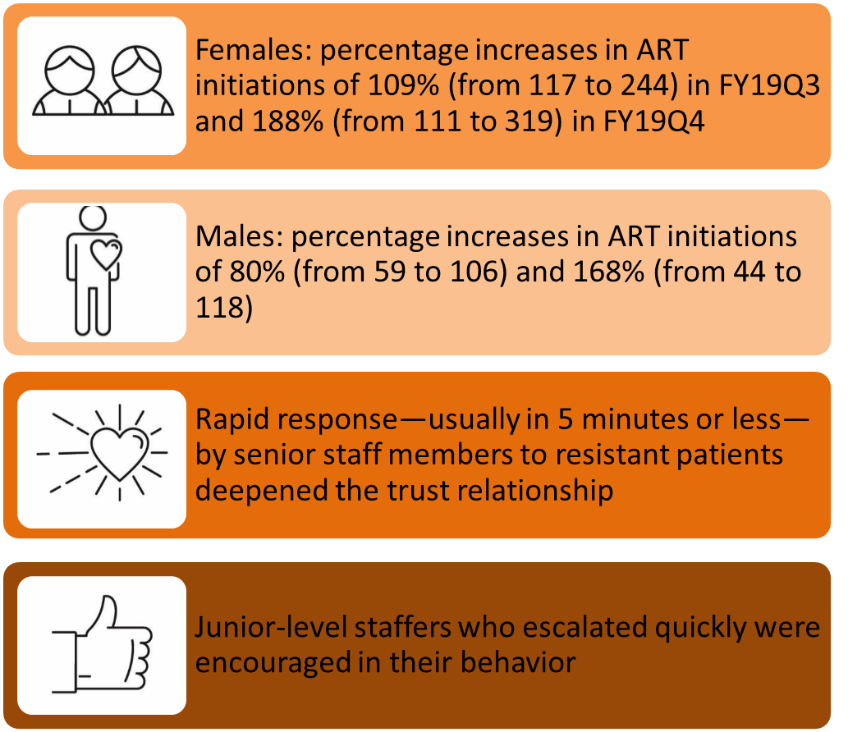
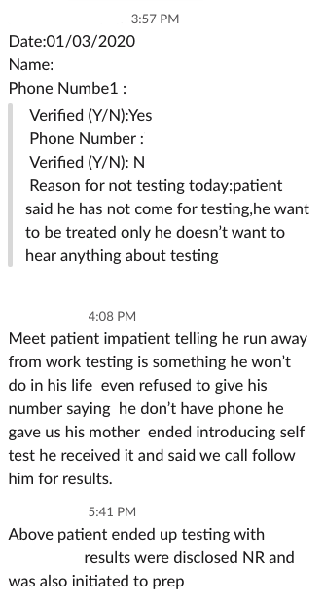

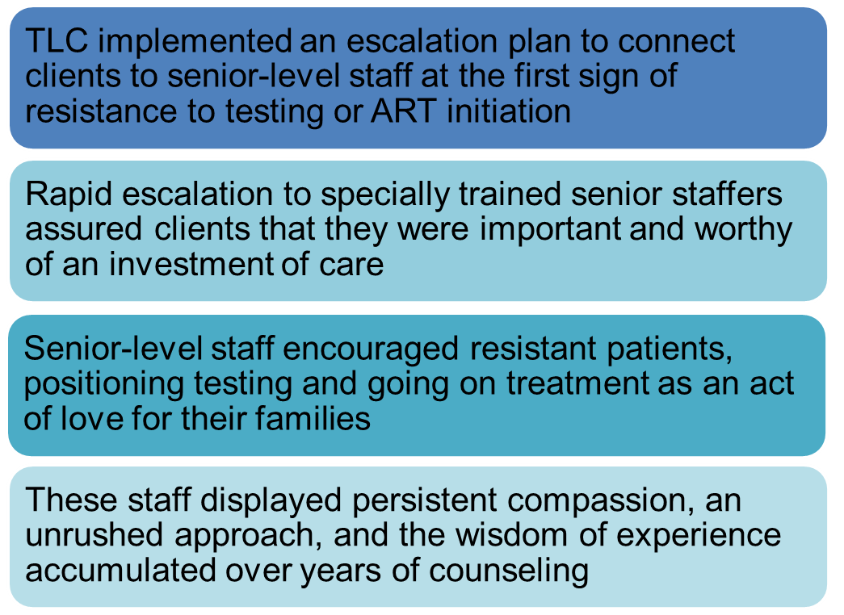

Maximizing Same-Day Antiretroviral Treatment (ART) Initiations by Implementing an HIV Testing and ART Initiation Escalation Plan, Integrated Screening, and Client Education
Authors: VanderWal, Echo; Benzerga, Wendy; Lukhele, Njabuliso
Background
Table 1: ART Initiations (Reporting Quarters/Gender)
Lessons Learned
Table 2: Screenshot of Communication Platform
Description
Conclusions / Next Steps
Critical elements of the model include:
    Training
    Communication platform for escalation
    Rapid escalation to skilled counselors
    Ongoing feedback/evaluation
Upskill junior-level staffers to become proficient in encouraging patients to test and initiate
Share model for possible duplication by other organizations in Eswatini
Contact: Echo VanderWal, The Luke Commission, Eswatini, vanderwal@lukecommission.org

