Slide 1
Operation Triple Zero Implementation in Kenya: Experience from Faith Based Health Facilities in Western Kenya
Dr. Milton Omondi
Program Director
Kenya Conference of Catholic Bishops (KCCB)
Kenya AIDS Response Program (KARP)
20 April 2022

Slide 2
Background
Kenya Conference of Catholic Bishops (KCCB) is a permanent assembly of the Catholic Bishops in Kenya
KARP, is an Ad Hoc commission within KCCB responsible for HIV prevention care and treatment in faith affiliated sites
Funded by PEPFAR/CDC and Supports 57 faith-affiliated sites in 9 counties of Western Kenya;
Supports total on ART 84,376 (March 2022)
<10Yrs - 2%;
10-19Yrs - 7%;
20+Yrs- 91%

Slide 3
Background: Adolescents and HIV
Negative Beliefs
Self Stigma
Discrimination
Sexual immorality often associated with a diagnosis of HIV
HIV is a punishment for those who have sinned
HIV diagnosis as a death sentence despite proven efficacy of ARVs
I hate myself and my mother for infecting me
If I disclose, I will lose friends, respect and become isolated
My peers do not want to associate with me
My peers use derogatory language to address me
Social rejection: some prefer clinics that allow them to keep their HIV status a “secret”.
Parents: “If you disclose, the whole family could be discriminated
Consequences: Nonadherence, attrition from care, withdrawal, psychological distress
Notes:
Reluctance to attend clinic because of fear of stigma (LTFU)
Non-adherence due to not telling others they are on a medication
Hiding medicines at school or taking medication in secret
Psychological distress: feeling depressed, ‘‘stressed,’’ ‘‘restless,’’ ‘‘losing hope” or “feeling suicidal”

Slide 4
Time for Programmatic Shifts
Programmatic observations
Suboptimal viral suppression for adolescents (68%)
No difference in viral suppression between those attending support group meetings and those who are not
Non-involvement of AYP in decisions
HCW worker attitude not conducive for adolescent care
Inability to navigate through health care systems
Objectives (in June 2017)
To have adolescent point person per facility by December 2017
To meaningfully involve peer mentors at every health facility by December 2017
To initiate OTZ Clubs across 57 health facilities by December 2017
To improve 12 month retention from 82% to >90% by 2020
To increase viral suppression from 68% to >90% by 2020
Notes:
Years of life lost to Disability (YLD)-(Belief that his/her life is worse off, worries a bout their future)
Goal of HCWs is to increase the QALYs and decrease DALYs.

Slide 5
Operation Triple Zero (OTZ)
Is an asset based strategy that meaningfully involves adolescents and young people in HIV prevention, care and treatment focusing on continuity of care and viral suppression
Operation Triple Zero
Primary Objectives
Secondary Objectives
Zero Missed Appointments
Zero AIDS Related Deaths
Zero AIDS Related Hospital Admissions
Zero Adolescent Pregnancies
Zero Stigma & Discrimination
Zero AIDS Related Missed School Days
Zero Missed Drugs
Zero Viral Loads
Notes:
Stigma addressed through:
OTZ club meetings: Facility based. Held monthly. For sharing experiences, reviewing challenges
OTZ camps: held annually
School health programs: collaboration between ministries of health & education. Trains school teachers and workers on stigma. Avoid special practices for CALHIV
HCW support: to gain skills on avoiding stigmatizing practices (eg calling clients as “high VL patients”)
Life skills training: How to handle/respond to stigmatizing comments/actions
Sports activities: Engage with parents & HCWs in sports, dances etc. Makes them realize that they aren’t unique.
Edutainment: Clubs develop video edutainment skits/plays

Slide 6
Methodology
Avail OTZ tools to sites (Registers, IEC materials..)
Monthly and quarterly review of performance
Adolescent open days/yearly OTZ camps/Election of officials
Enroll into social media platforms for motivational messaging
Orientation of facility staff on OTZ
Enroll adolescents into OTZ and go through the OTZ modules
Identification and orientation of AYP OTZ champions per site
OTZ Package of Care
Adherence, psychosocial support
Prevention messaging
Motivational messaging
Referrals, linkages
Treatment literacy
OTZ clubs/camps/school health clubs
eCommunication through WhatsApp

Slide 7
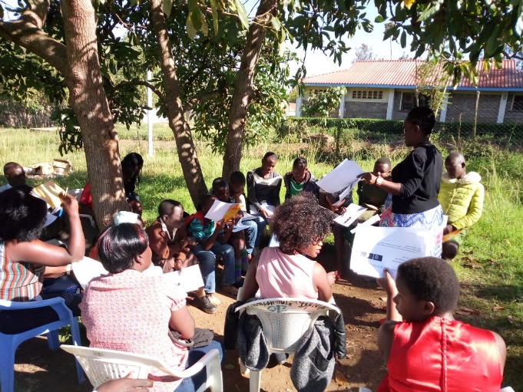
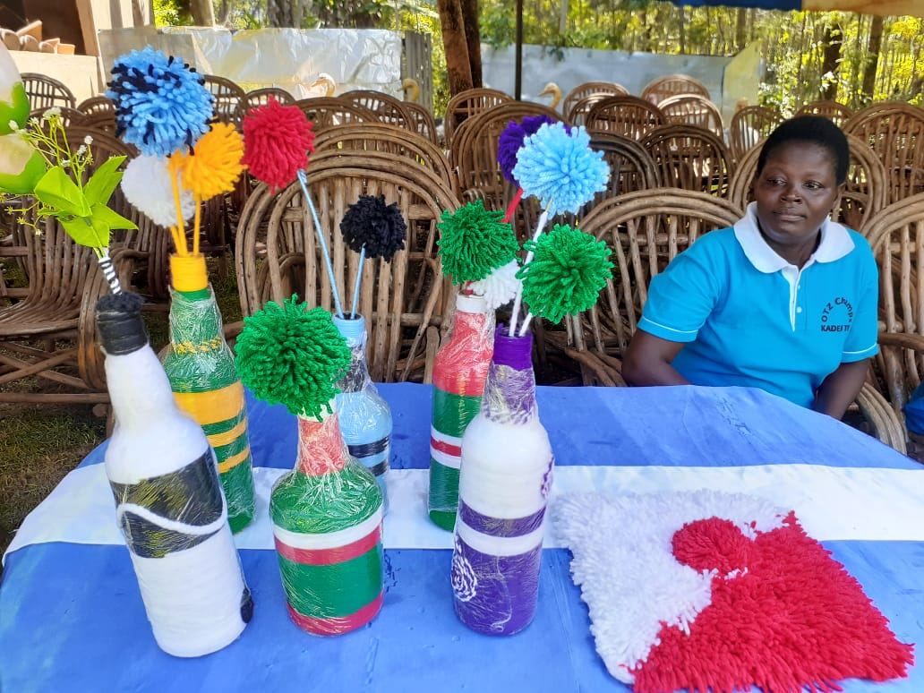
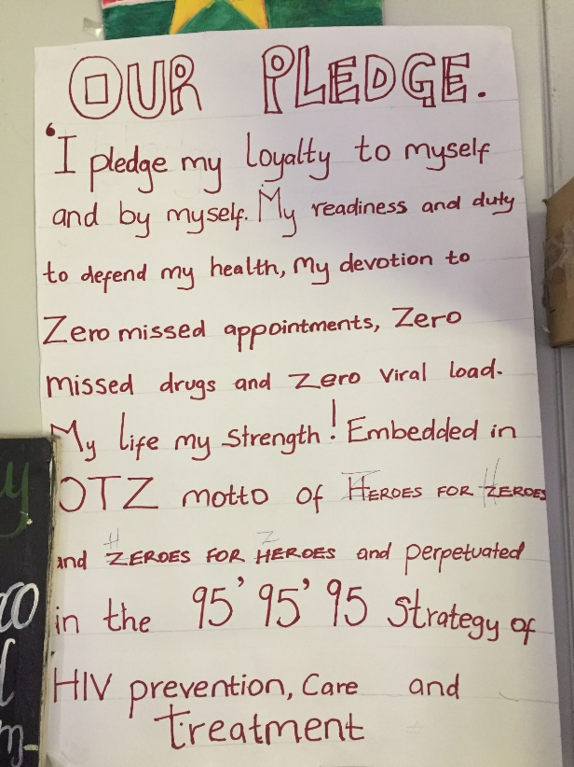
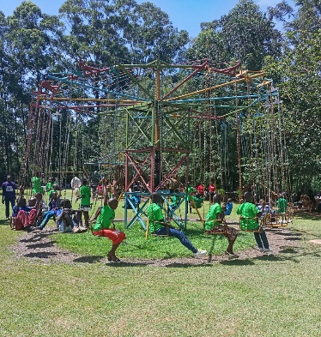
Activities During OTZ Club Meetings
Self introductions: name, date diagnosed/enrolled, challenges, how they overcame
Peer to peer support
Health therapy sessions
IGAs
Life skills support and career counselling
Lessons on topic of their choice
Watching educative videos
Edutainments (poems, skits, dances)
Maxims (heroes voices documentation)
MMD
Play and ART therapy
Health education
Income generating activities
Play therapy
Notes:
Annual virtual OTZ Camps
Please call me, SMS
Audio DOTS
Virtual counselling
Whatsapp platforms
Videos
OTZ Face book page
Observing MOH measures

Slide 8
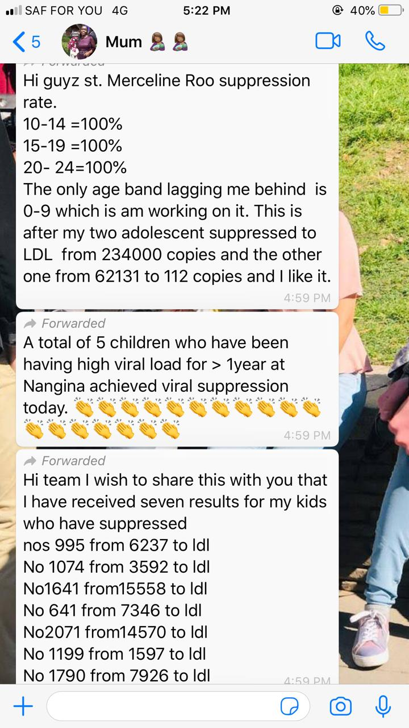
Using Online Platforms to Support Adolescents
Virtual OTZ camp 2020
Notes:
Include FB Page screen shot

Slide 9
Results: Improved Viral Suppression Across all Facilities Scale Up of sites from 3 (5%) in July 2017 to 57 (100%) by October 2017
Trends in Proportion of Clients Achieving Viral Suppression
Viral Suppression/Site FY21Q4
*Viral Suppression: <1,000 copies/ml)
Notes:
Facility Suppression Rates
>95%: 15 (26%)
90-95%: 26 (46%)
<90%: 16 (28%)
Proportion of adolescents who keep clinic appointments

Slide 10
OTZ Testimonials
How did you disclose?
How can we better serve you?
How can we support one another to offer better services?
“I got pregnant when I was already infected with HIV, that’s when he also got infected” (5 M.O)
“He started acting up when it was time to take his medicines, so I was force to be more involved”(5.L.A)
“its great. At least now when he is tested, his VL is LDL” (5 C.A)
“Have more meetings” (5. c.A)
“Allow us to meet with other facilities to have activities” (5.F.O)
“Check our blood more often so that we can know our VL (5.E.O)
To be open about my status
To be a role model and overcome my fears (5. UKN)
“May be we go to other facilities in other regions, to benchmark within ourselves”(4.J.M)
“I want to thank the program for bringing in the care-givers, at least today we have different OTZ meetings, at least today we have met with their parents” (4.A.R)
“OTZ sustainability is really key” (4.S.O)

Slide 11
Lessons Learnt
Asset-based programming ensures there is meaningful involvement of adolescents in their own health care
Data demand and information use enhances decision making process
e-Communication hastens information sharing and action (adolescents, HCWs, caregivers)

Slide 12
Thank You
Disclaimer: The findings and conclusions in this report are those of the author(s) and do not necessarily represent the official position of the US Centers for Disease Control and Prevention and other funding agencies.
Support: This publication/report was supported by Cooperative Agreement Number 5NU2GGH002035 from the US Centers for Disease Control and Prevention. Its contents are solely the responsibility of the authors and do not necessarily represent the official views of the US Centers for Disease Control and Prevention, the Department of Health and Human Services, or the U.S. government.

