Slide 1
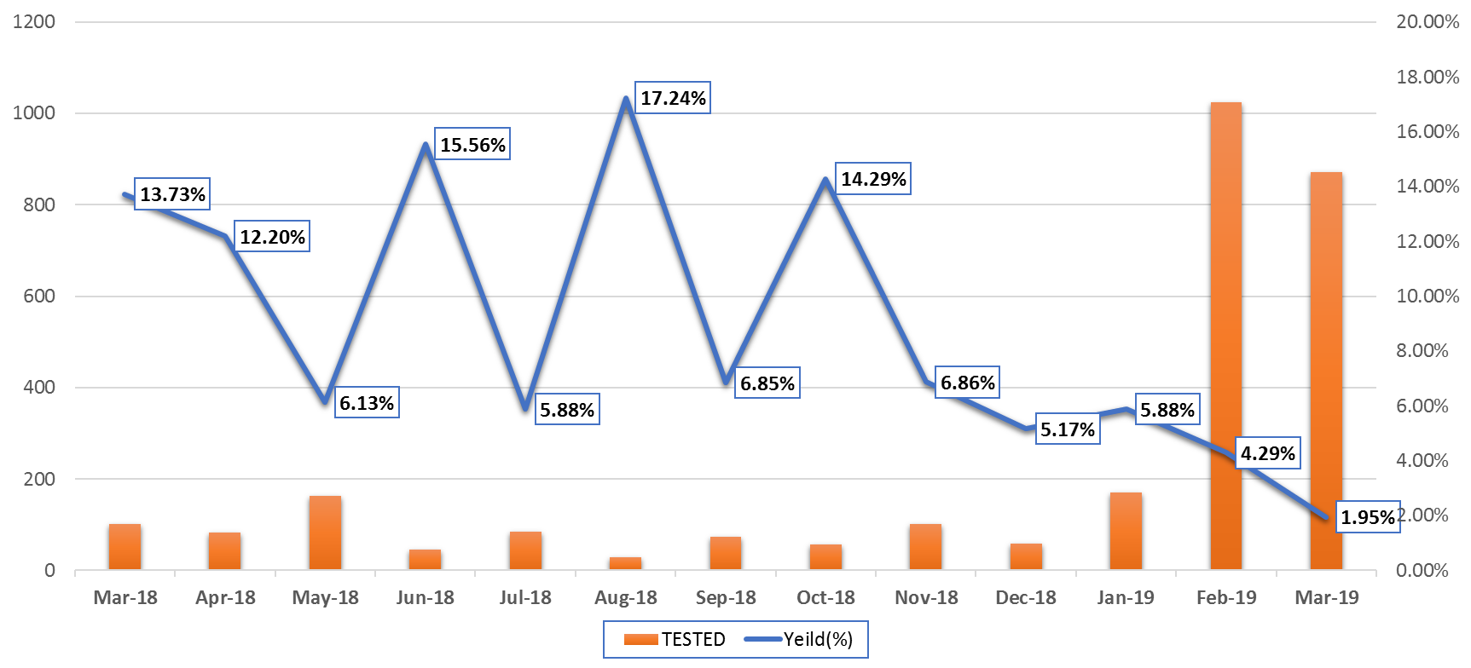
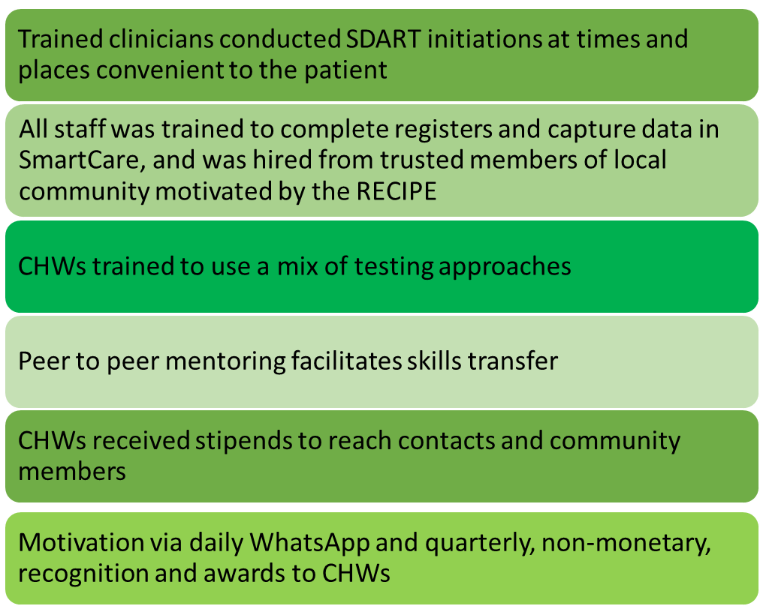
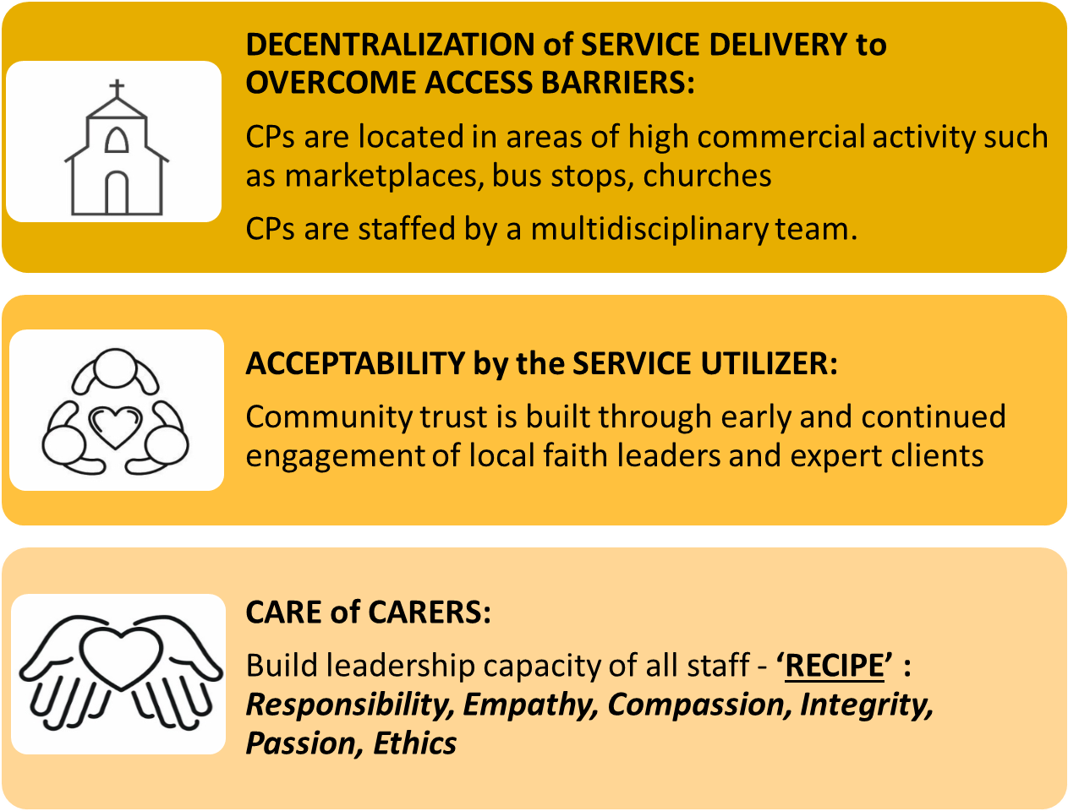
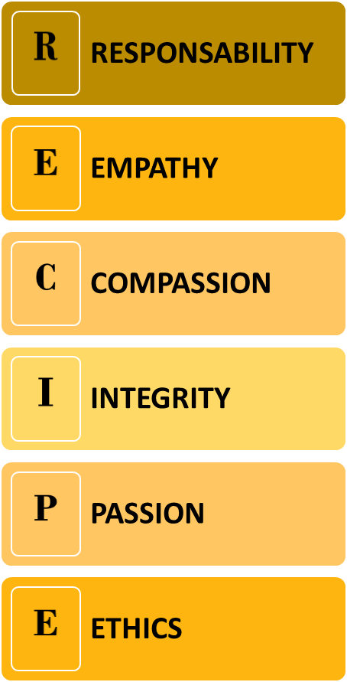
Faith-engaged community posts associated with over 1200% increase in new HIV case ascertainment, with high linkage and retention, Zambia
Gibstar Makangila¹, Albert Mwango², Minesh Shah³, Nzali Kancheya⁴, Kennedy Nkwemu⁴, Isaac Zulu³, Idongesit Essiet-Gibson³, Lauren Erickson Mamane³, Simon Agolory⁴, Susan Hillis⁵ 1 Circle of Hope (COH), Lusaka, Zambia; 2 Catholic Relief Services (CRS), Lusaka Zambia; 3 CDC, Atlanta, GA, USA; 4 CDC, Lusaka, Zambia; 5 Office of the Global AIDS Coordinator, Washington, DC, USA
BACKGROUND & DESCRIPTION
LESSONS LEARNED
CONCLUSIONS
In March 2018, to increase HIV case-finding, linkage, and retention particularly among men and children, Circle of Hope (CoH) and Catholic Relief Services (CRS) started engaging faith leaders and deploying faith community members to de-centralized community posts (CPs).
The faith-engaged CP model results in substantial improvements in case-finding, linkage, and retention.
Replicating it may help advance epidemic control.

