Slide 1
Integrated Spiritual Support in a
Comprehensive Health Care Platform
Echo VanderWal - The Luke Commission
New Foundations of Hope Webinar
August 24, 2022

Slide 2
The TLC Mission
To deliver compassionate, comprehensive healthcare to the most isolated and underserved populations of southern Africa in collaboration with local communities, government, corporate and non-profit partners
Notes:
TLC = Tender Loving Care
Today, planning to look at spiritual care through the lens of the TLC COVID response, but applies equally to all.
We cannot heal everyone, but we can love everyone
Spiritual care is for everyone: patients, families/loved ones, staff, and I will share about each of these areas.

Slide 3
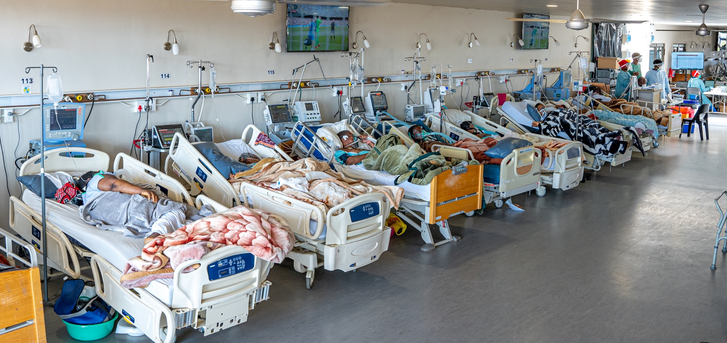
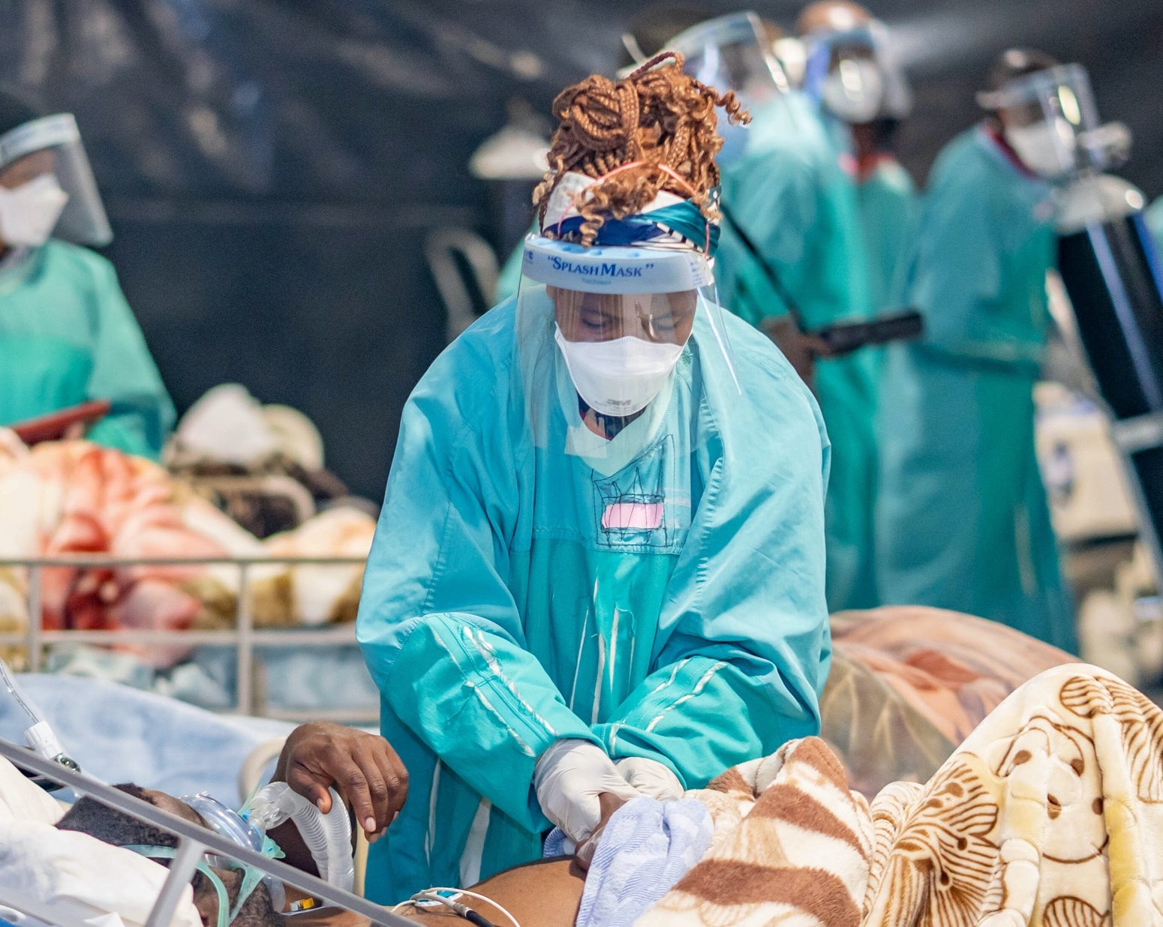
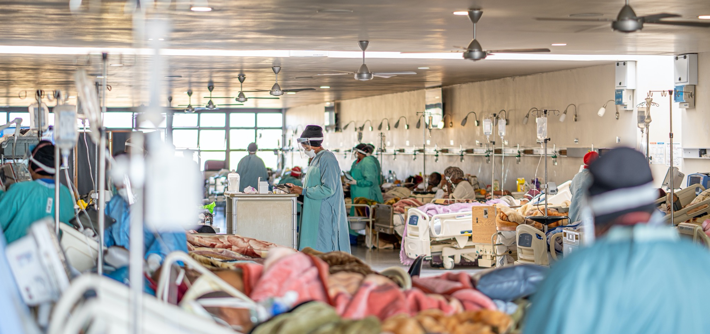
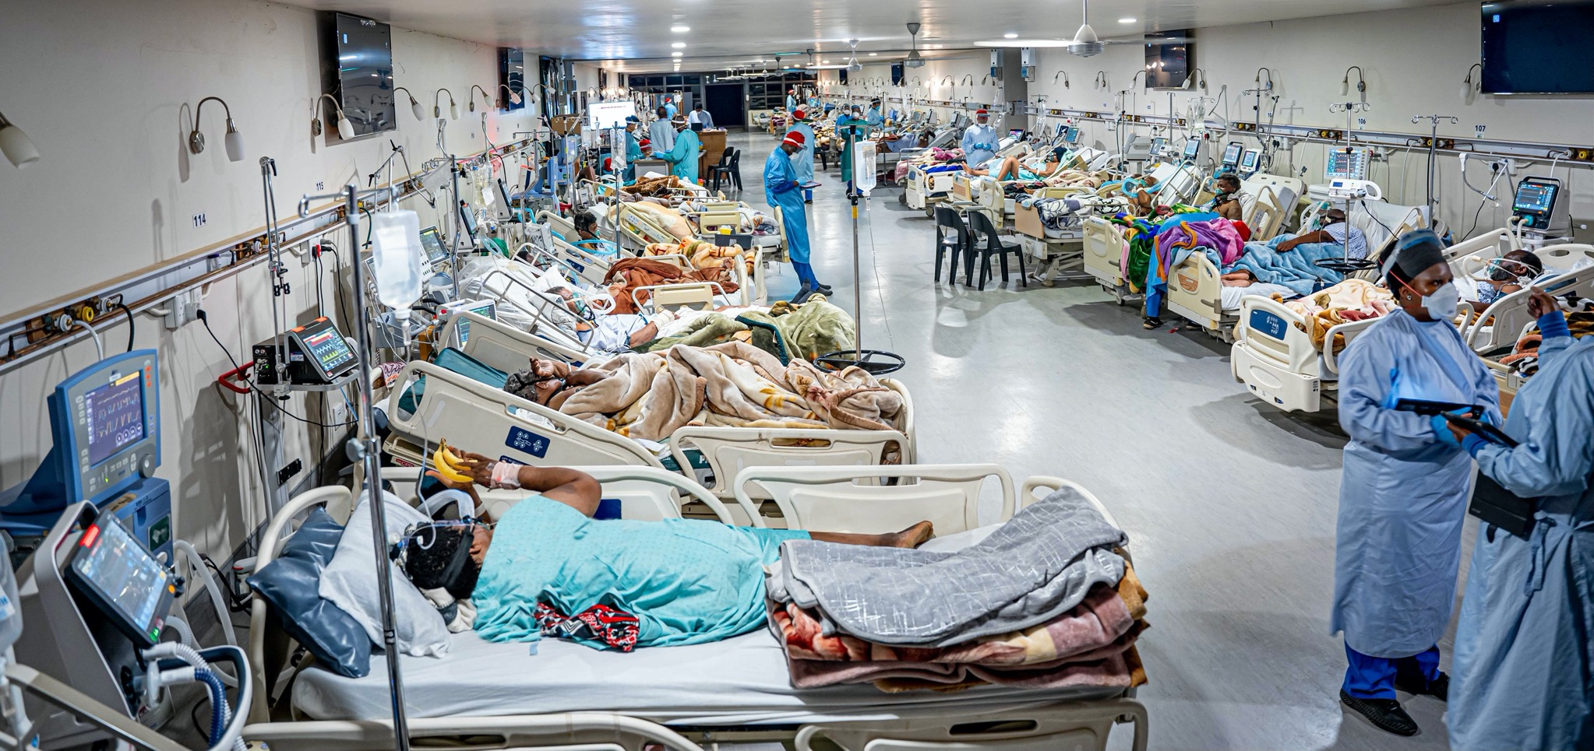

Slide 4
Patients: Spiritual/Psychosocial Support
Challenge
Solution
COVID-19 patients feel exceptionally isolated from family, are unable to speak when on ventilatory support with a mask, and struggle with fear and anxiety
Spiritual care team greets each patient in the inpatient ward each morning and evening and prays with anyone desiring prayer
On-campus church services offer encouragement

Slide 5
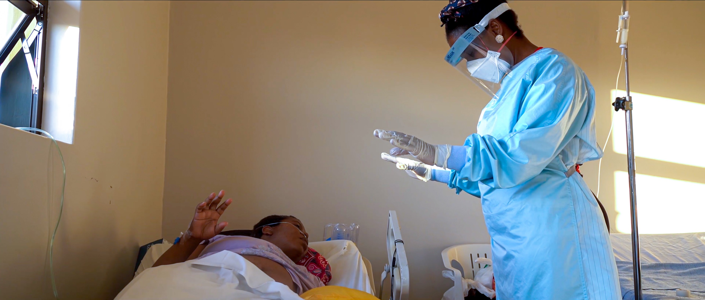
Notes:
We recognized the extreme anxiety of patients critically ill with COVID, especially with family members not able to provide normal caregiver support. When COVID came and caregivers left the hospitals, we lost a treasured member of the health care team. In response to the caregiver crisis, we trained a team of breathing coaches who stood next to the bed of every critical patient to ensure that patients were comforted, encouraged, and loved.

Slide 6
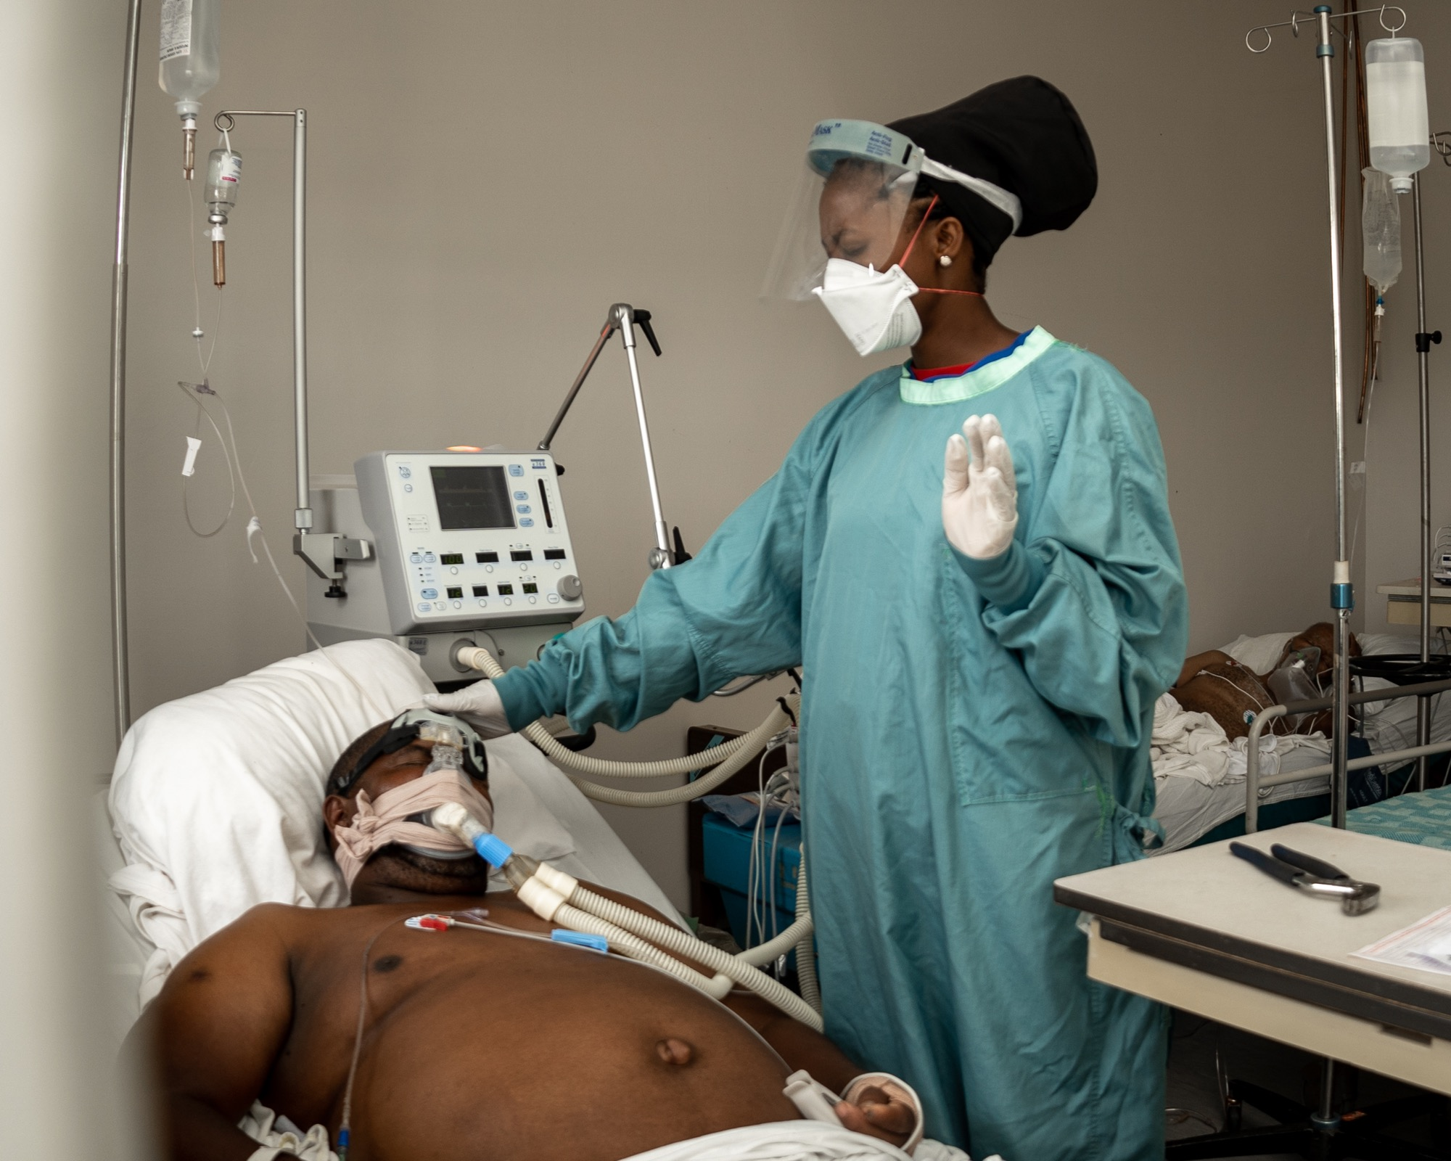

Slide 7
Patients: Respiratory Support
Challenge
Solution
In a medical environment, connected to machines, the anxiety of patients may lead them to breathe shallowly, reducing oxygen saturation
Breathing coaches accompany all severe and critical patients, encouraging deep breathing, monitoring respiration rate and other vitals, and praying with anyone desiring prayer
Notes:
The pictures of people praying for others and breathing coaches are very similar – this is integrated care!

Slide 8
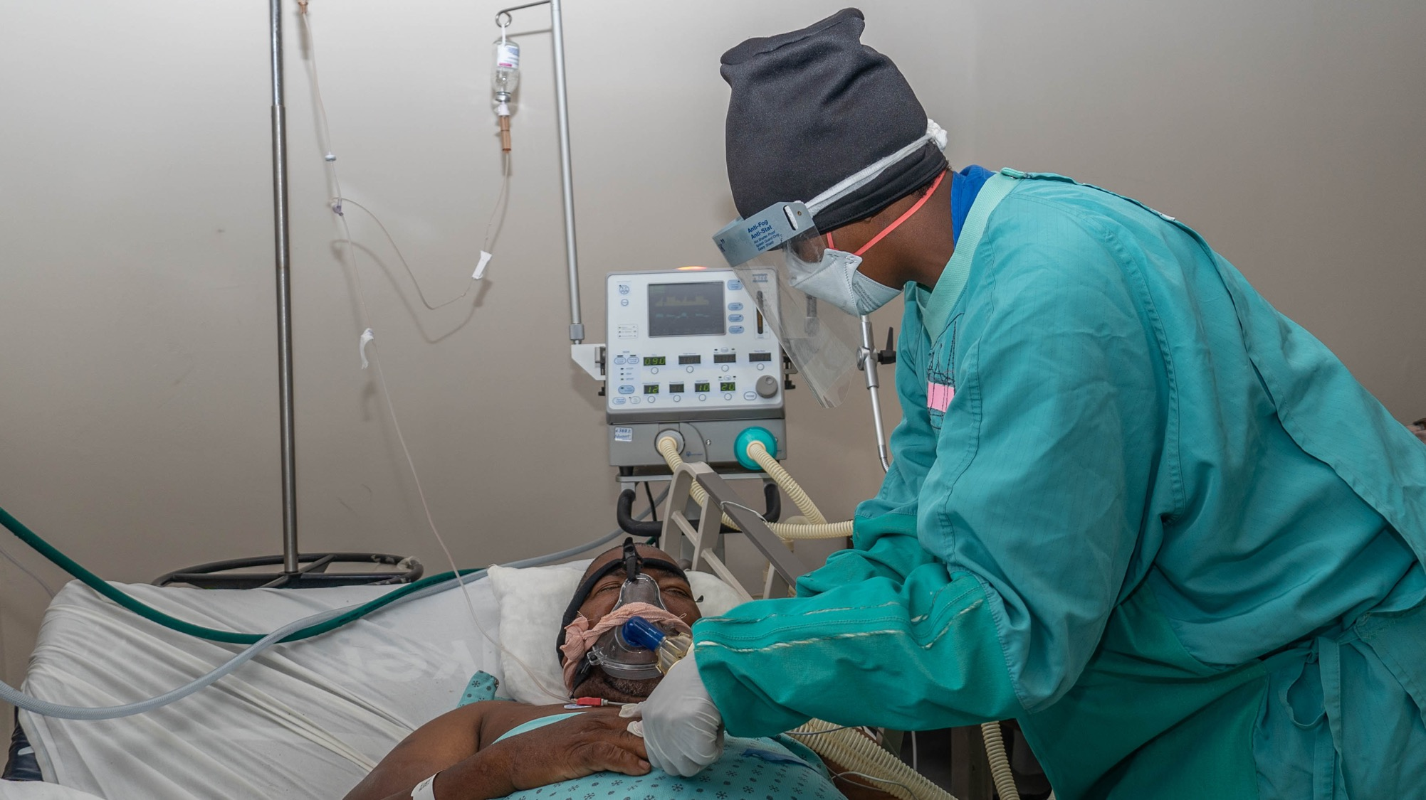
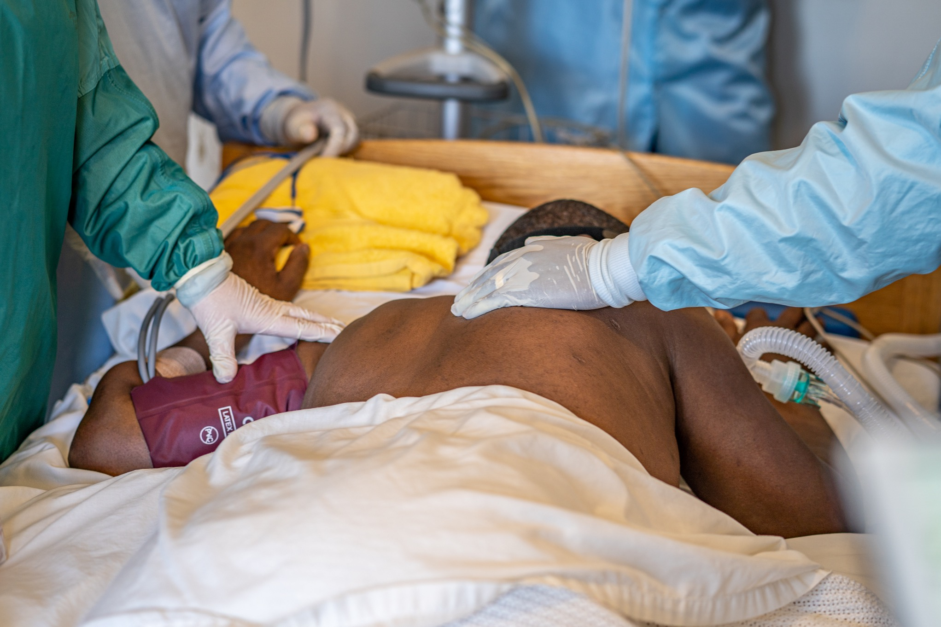
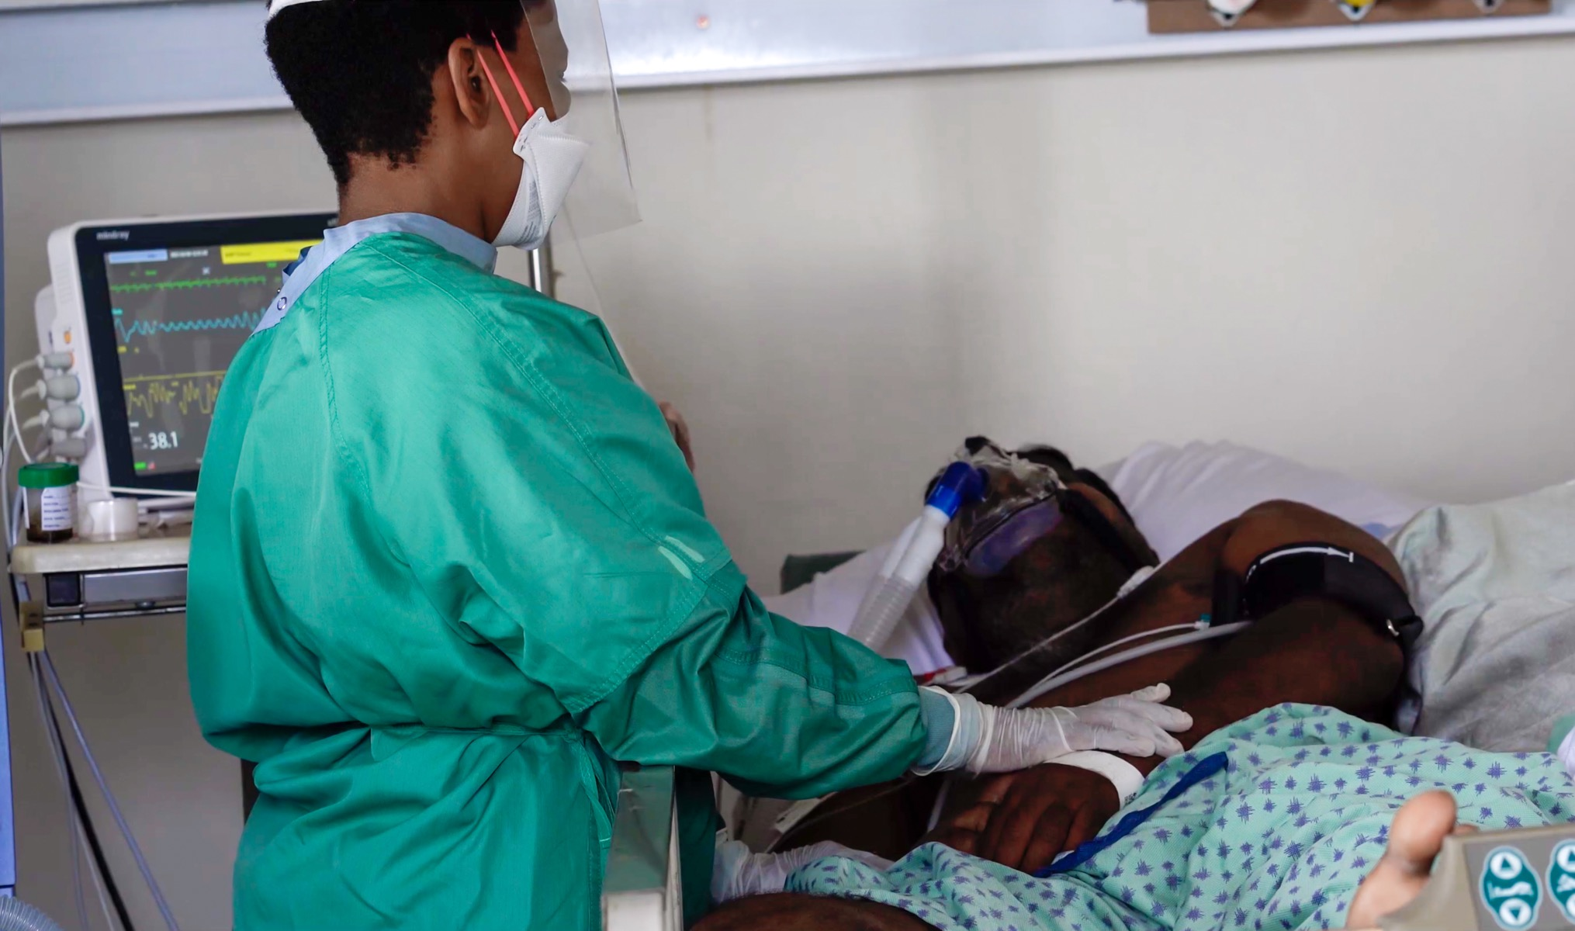
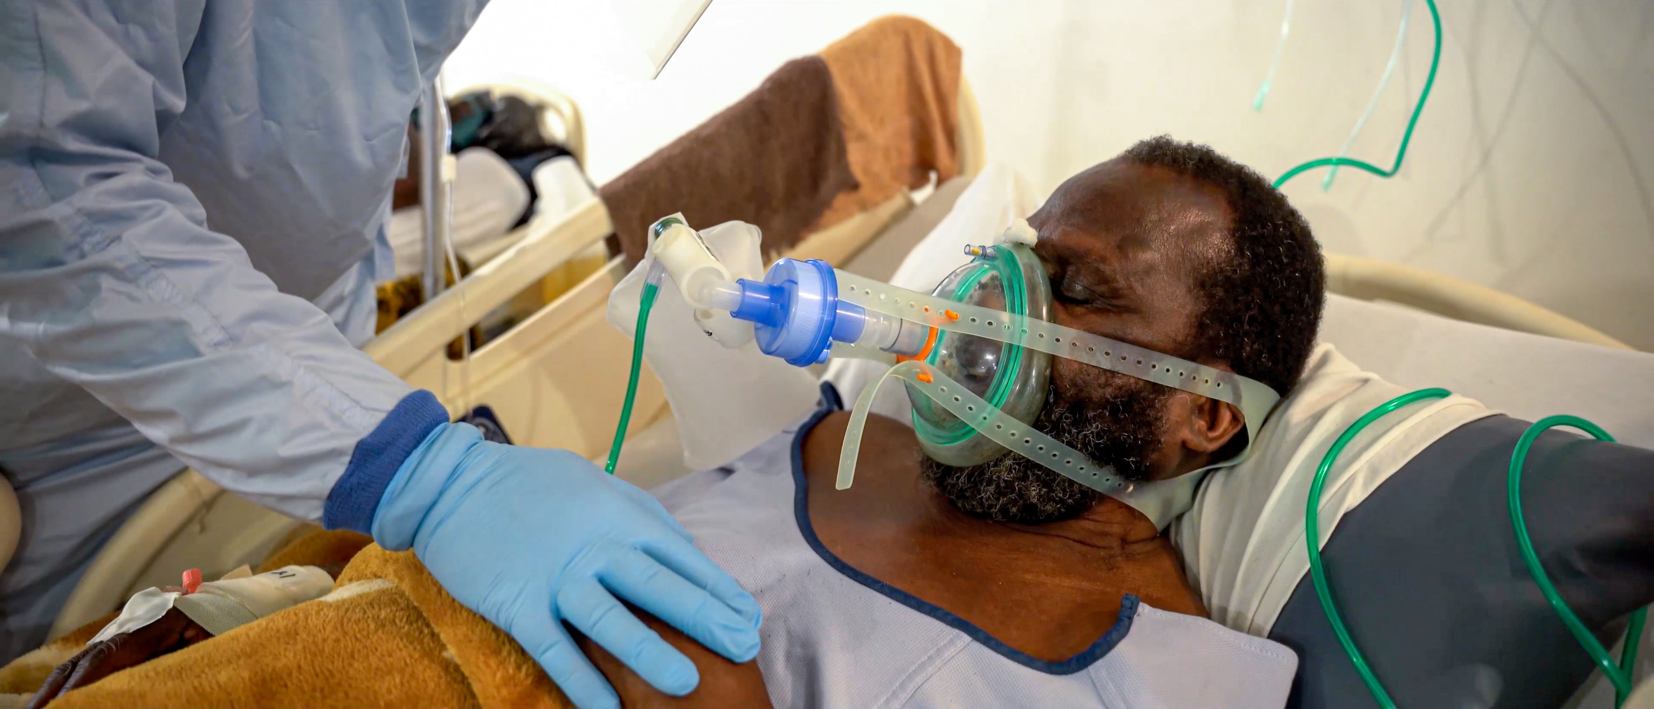
Notes:
We recognized the extreme anxiety of patients critically ill with COVID, especially with family members not able to provide normal caregiver support. When COVID came and caregivers left the hospitals, we lost a treasured member of the health care team. In response to the caregiver crisis, we trained a team of breathing coaches who stood next to the bed of every critical patient to ensure that patients were comforted, encouraged, and loved.
They immediately alerted the doctors and nurses when the patient needed medical assistance. This allowed the doctors and nurses to do what only they could do, and at the same time made sure patients felt safe and loved during some of the most traumatic days of their lives. Patients were never alone.

Slide 9
Notes:
We recognized the extreme anxiety of patients critically ill with COVID, especially with family members not able to provide normal caregiver support. When COVID came and caregivers left the hospitals, we lost a treasured member of the health care team. In response to the caregiver crisis, we trained a team of breathing coaches who stood next to the bed of every critical patient to ensure that patients were comforted, encouraged, and loved.

Slide 10
Families: Relational/Spiritual Support
Challenge
Solution
Family members fear becoming infected
Family members may come all at once
Family members bear the burdens of deep anxiety, worry, frustration, and grief
Allocated additional PPE
Established guidelines on visit length, numbers
Staffed family care managers at entrance and ward
Made all spiritual support services available to all family members on request

Slide 11
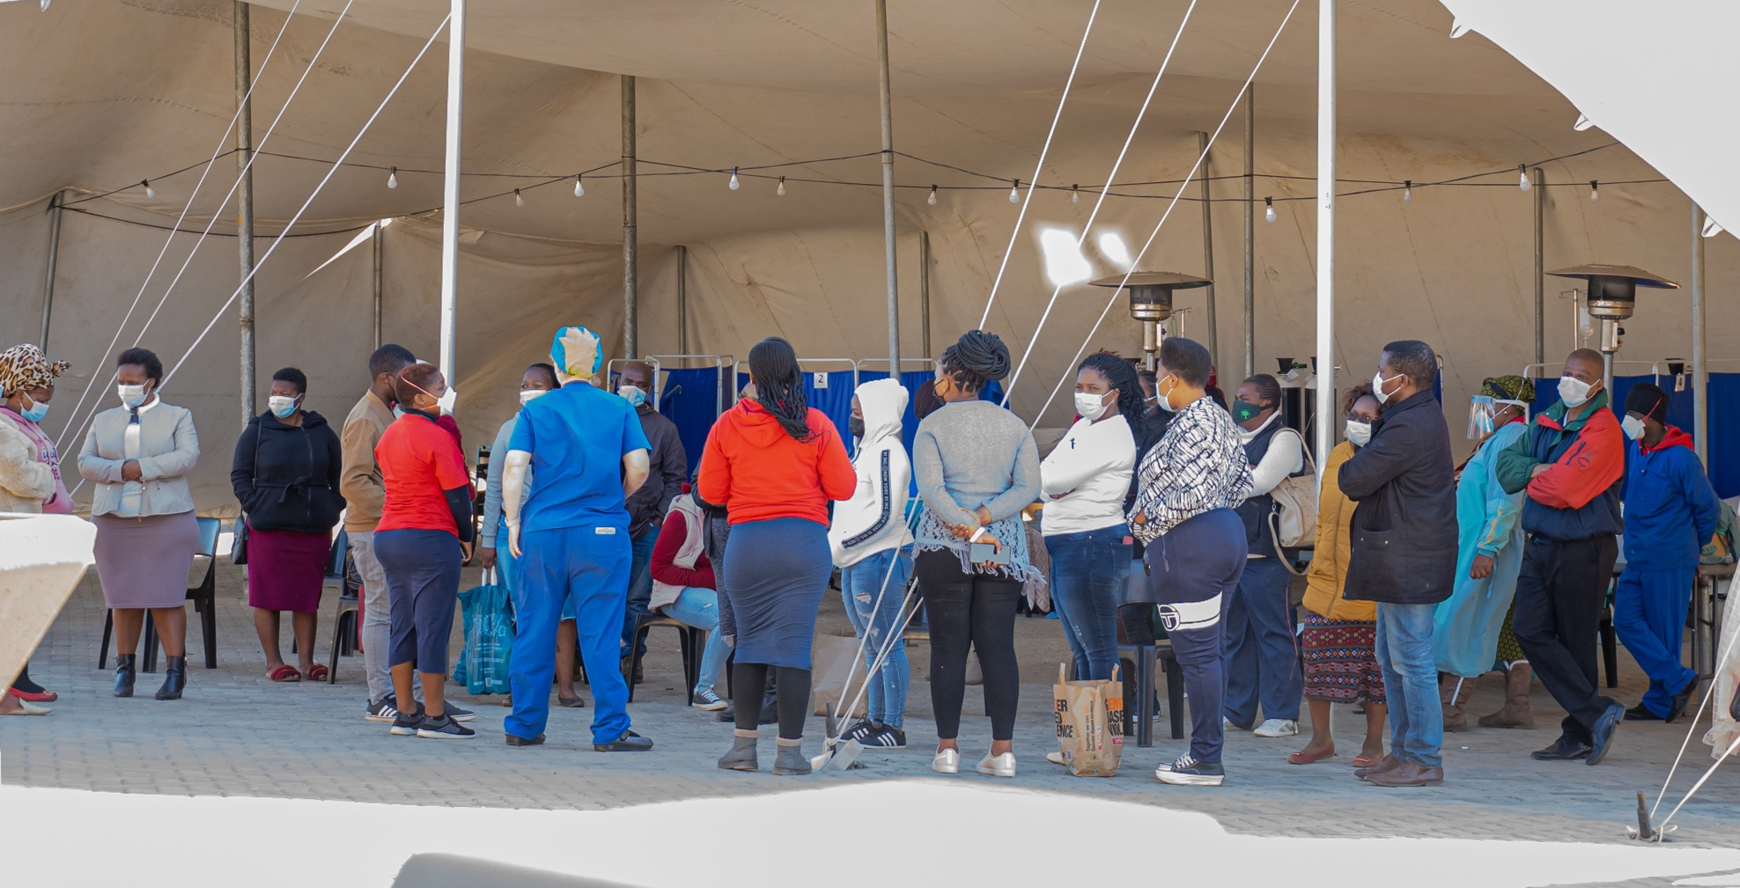
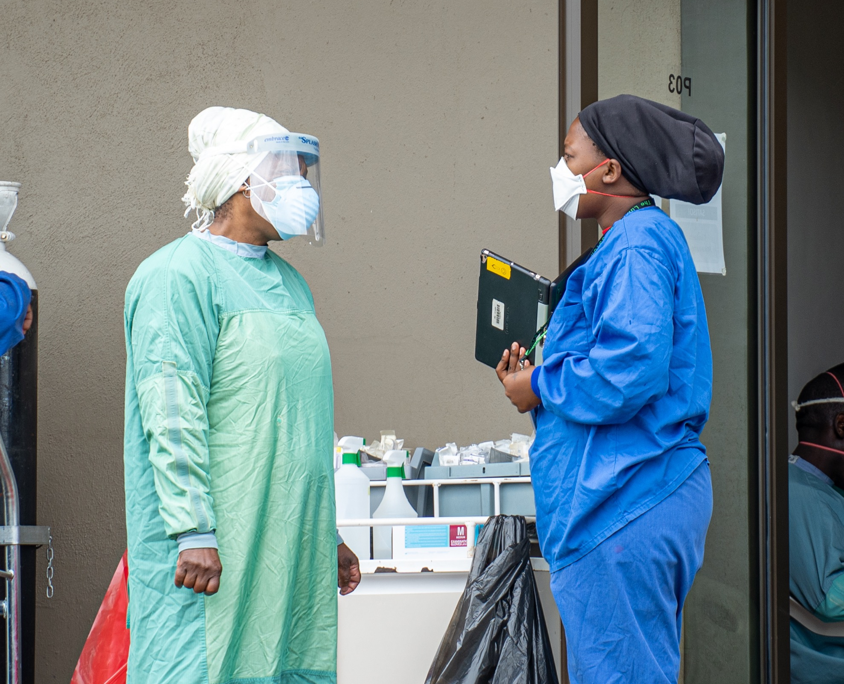
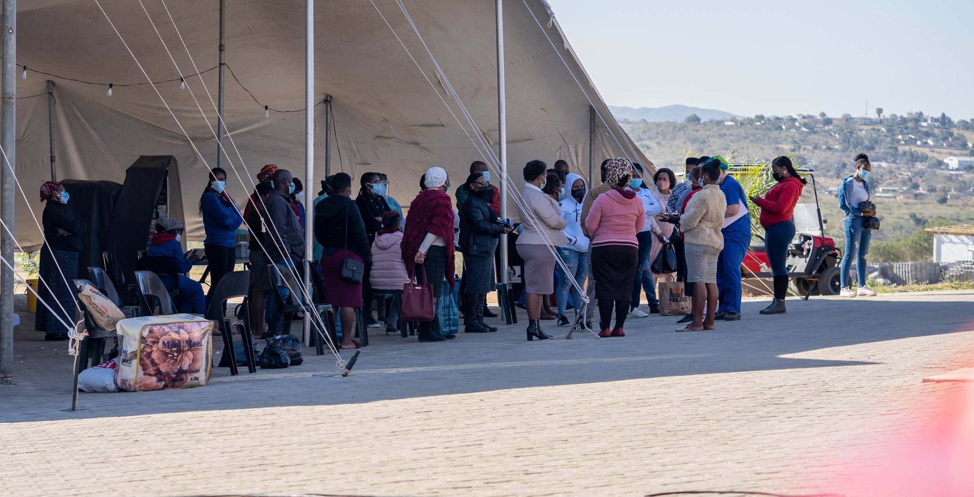
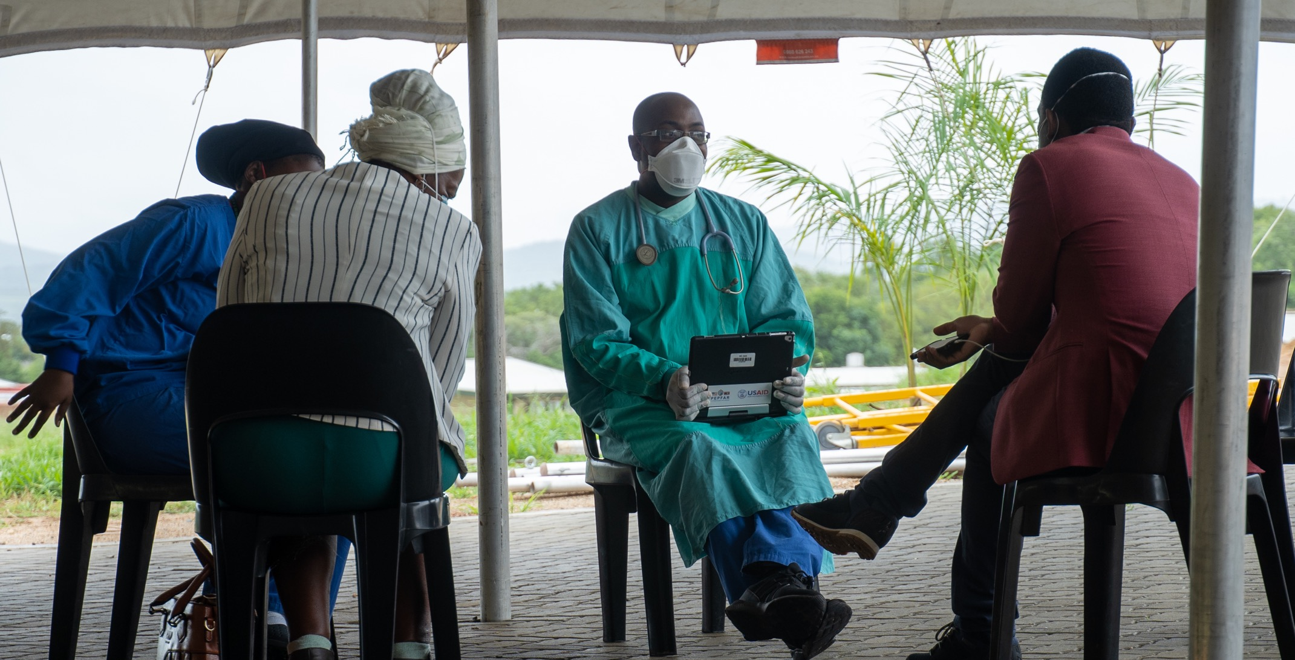

Slide 12
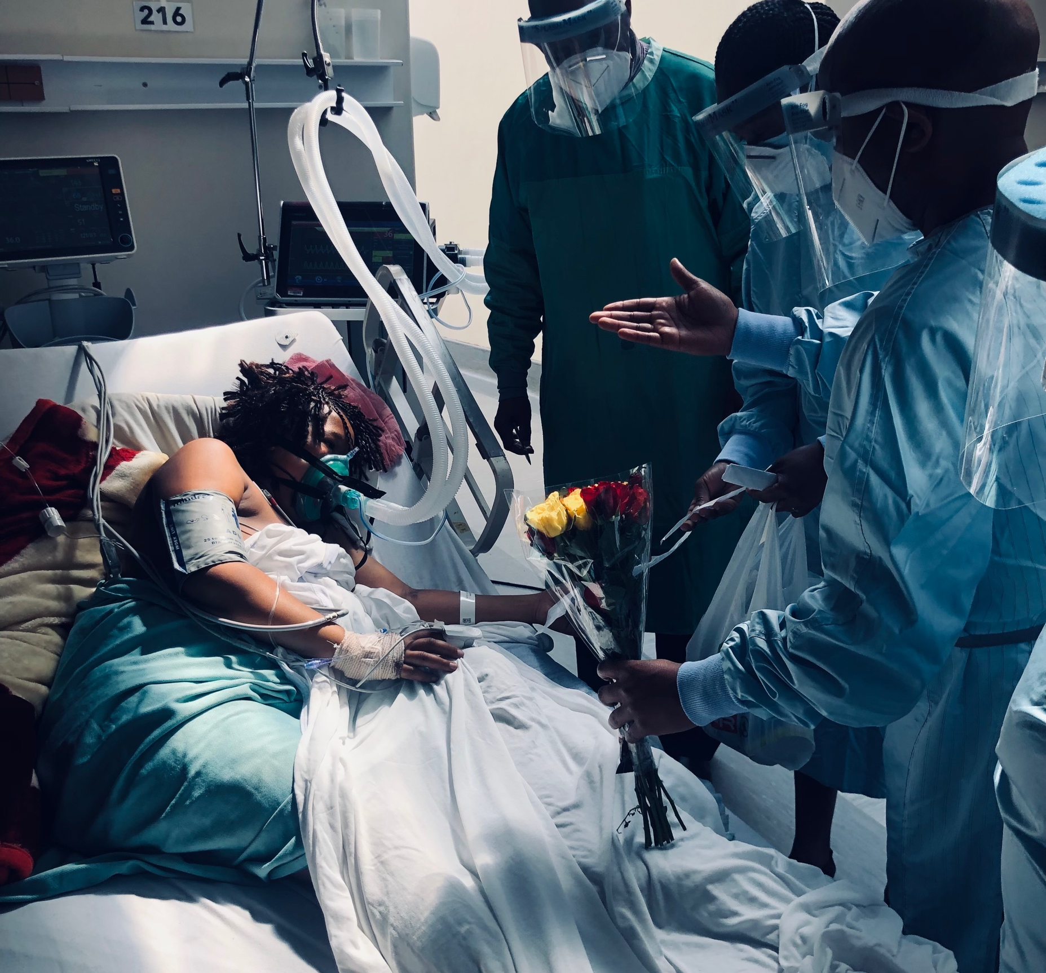
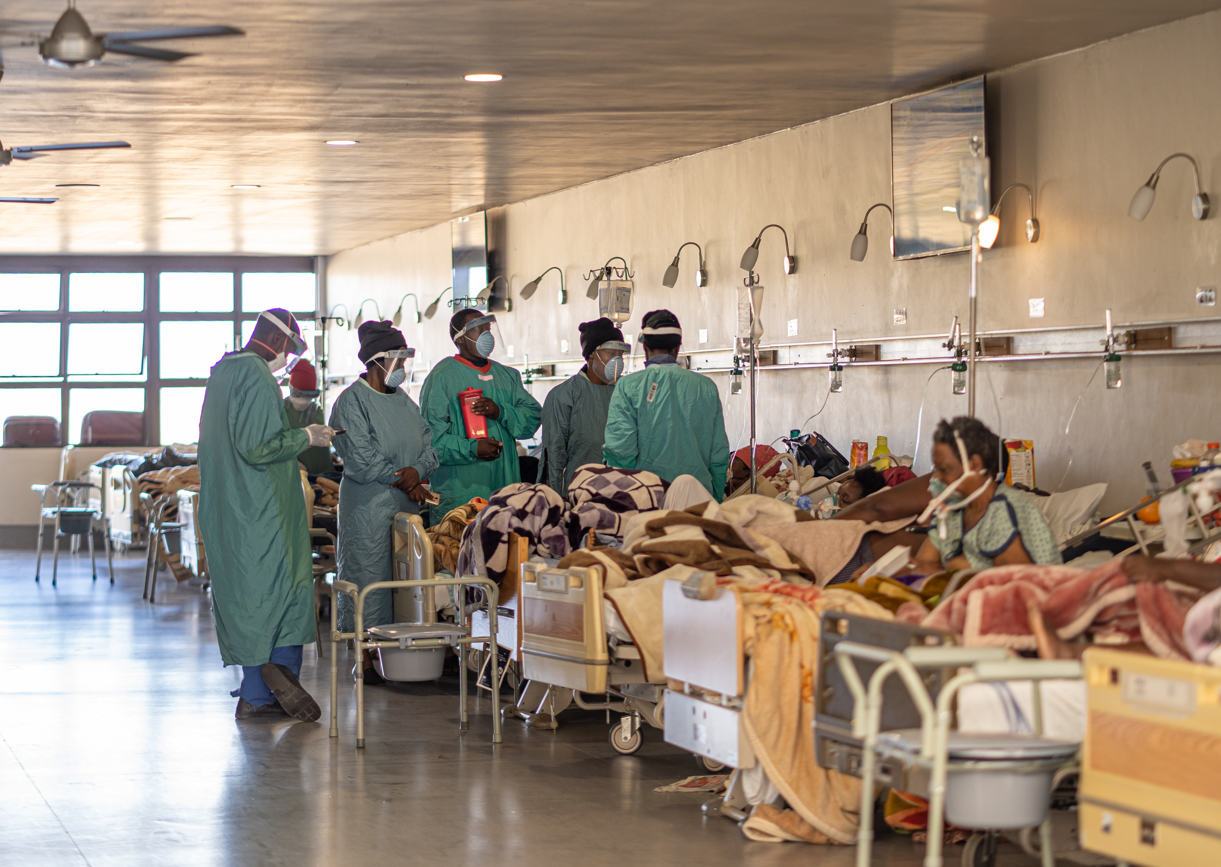
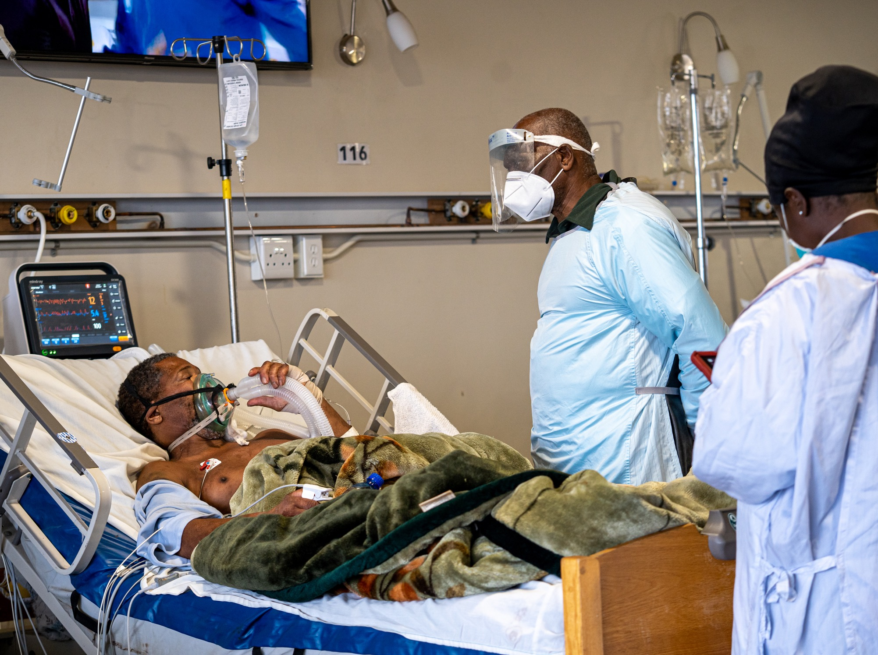
https://us02web.zoom.us/j/89463252874?pwd=Wjd0bGhNK2dudDgwUk5zd3ZwTk53dz09&from=addon https://us02web.zoom.us/j/89463252874?pwd=Wjd0bGhNK2dudDgwUk5zd3ZwTk53dz09&from=addon

Slide 13
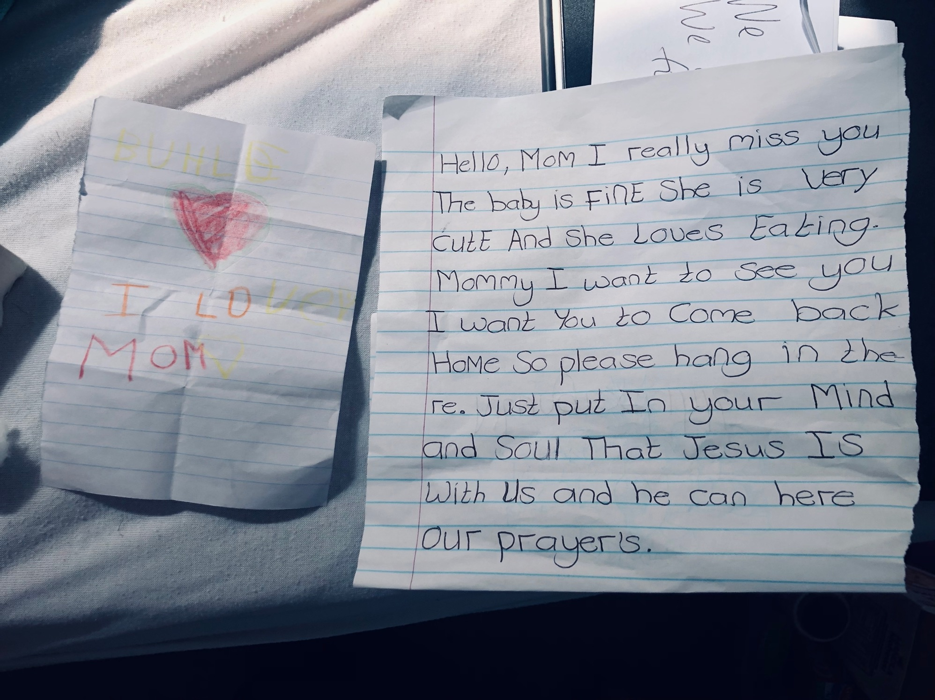

Slide 14
Staff: Spiritual Rhythms and Counseling
Departments begin the day with prayer, inviting God’s leadership and guidance for the challenges and opportunities of the day
All staff are free to request counseling at any time
Spiritual care team meets with staff before/after each shift
Staff are also invited to participate in ongoing personal or spiritual growth opportunities

Slide 15
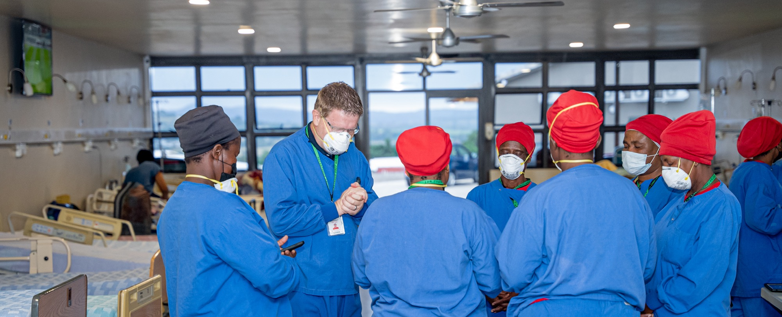
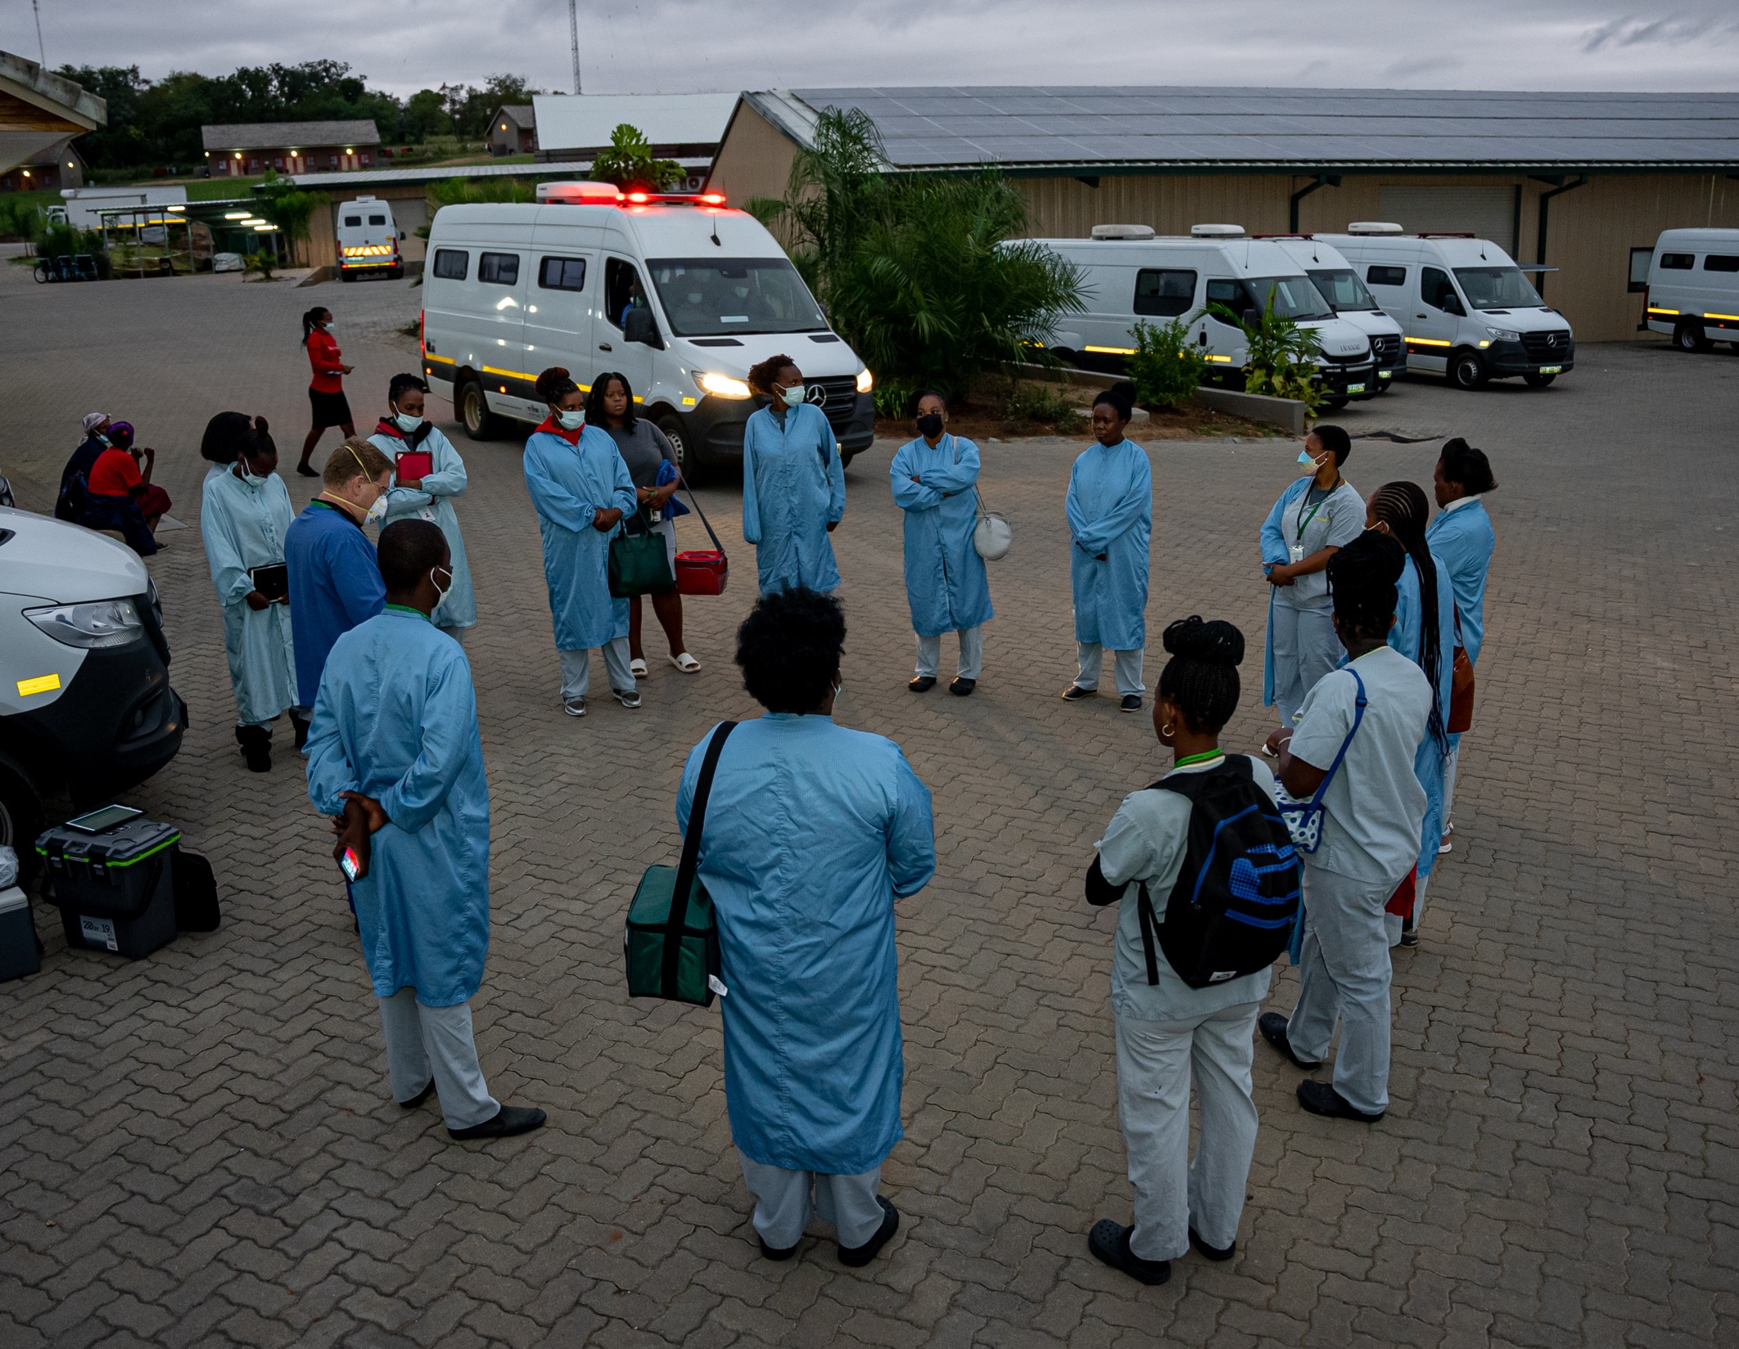
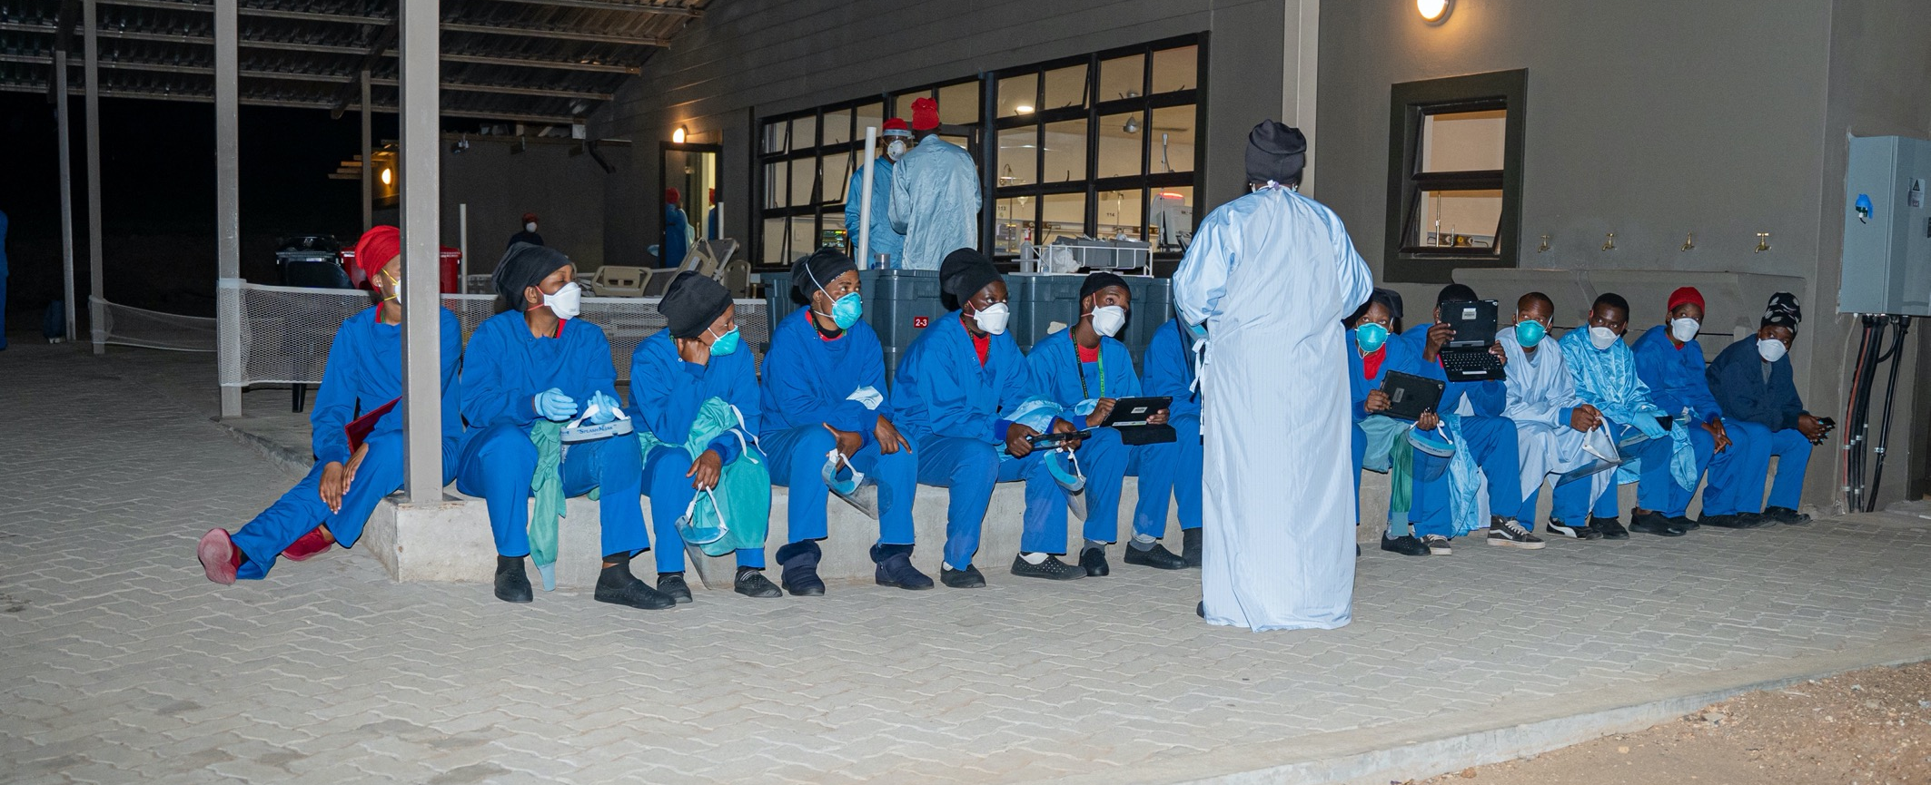
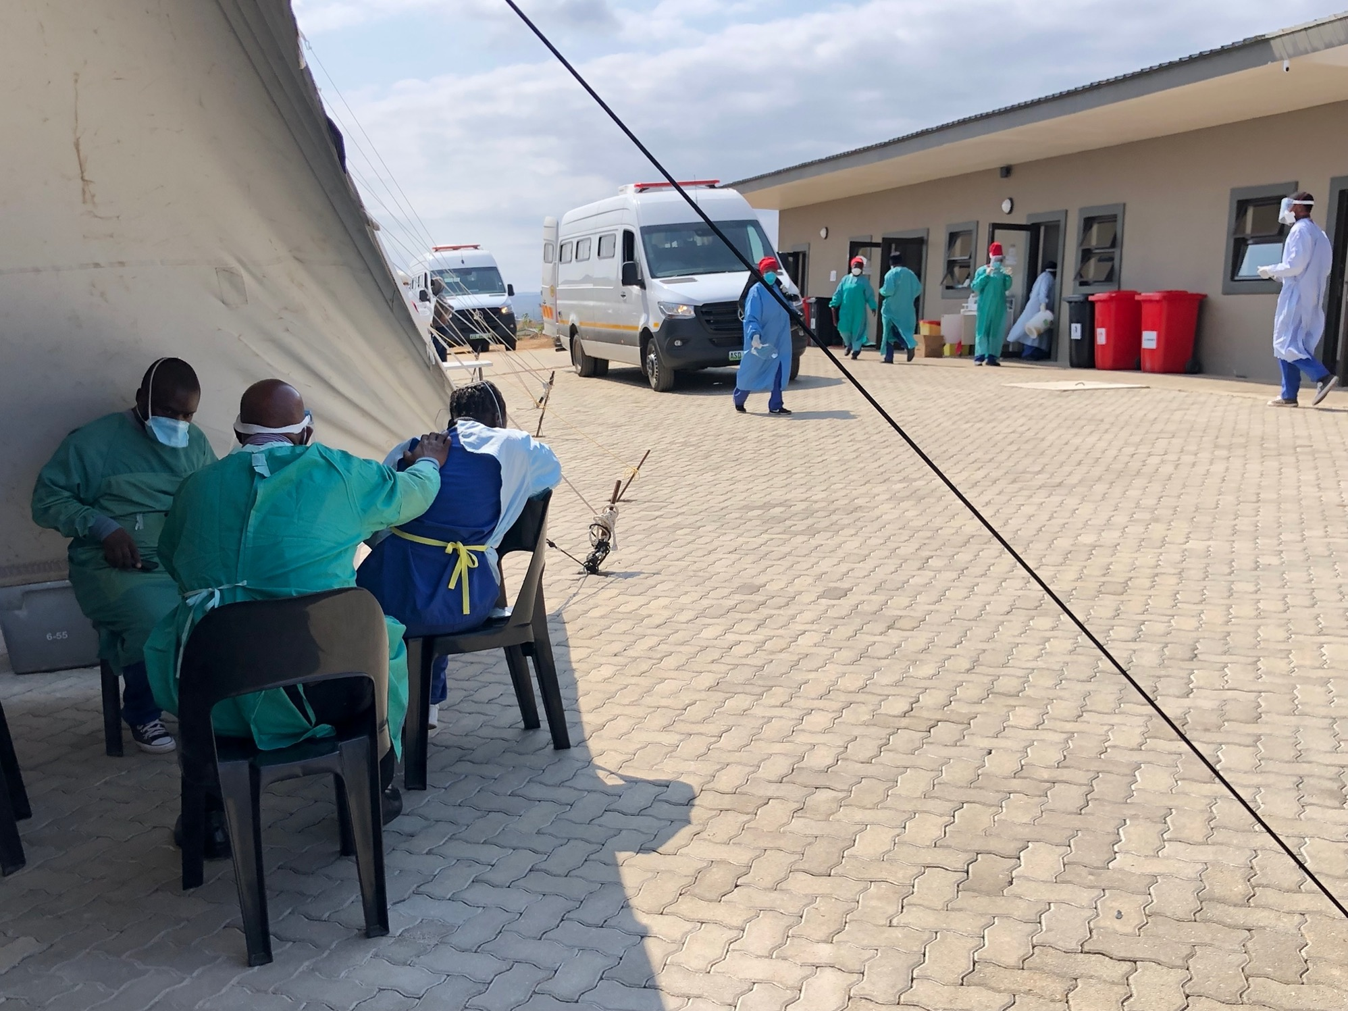

Slide 16
Compassion: The Heartbeat of Faith
“The principle of compassion lies at the heart of all religious, ethical and spiritual traditions, calling us always to treat all others as we wish to be treated ourselves. Compassion impels us to work tirelessly to alleviate the suffering of our fellow creatures, to dethrone ourselves from the centre of our world and put another there, and to honour the inviolable sanctity of every single human being, treating everybody, without exception, with absolute justice, equity and respect.”
- from the Charter for Compassion
Notes:
-One thing that we have witnessed over the last 17 years is that compassion never, ever fails.
-We know that we cannot heal every person. This is the brutal reality.
-But we know that we can love every person. This is the faith-filled promise.
-Compassion is a limitless resource in a resource-limited world. When compassion is deeply integrated and consistently expected from every staff member—gardeners, construction workers, cleaners, caregivers, engineers, executives, doctors, nurses, security guards, everyone—the atmosphere changes.

Slide 17
Notes:
Spiritual support creates optimal conditions for healing. When patients feel loved and accepted, they share openly with caregivers. They are not alone. In the face of suffering, they dare to hope.

