Slide 1



Maintaining HIV progress amid COVID-19 by utilizing Faith & Community Structures & Networks working in HIV CoH Community Posts
Gibstar Makangila
Executive Director
Circle of Hope, Lusaka Zambia
New Foundations of Hope
Webinar July 2020
Notes:
Today I want to talk for 5 minutes about (read slide).

Slide 2
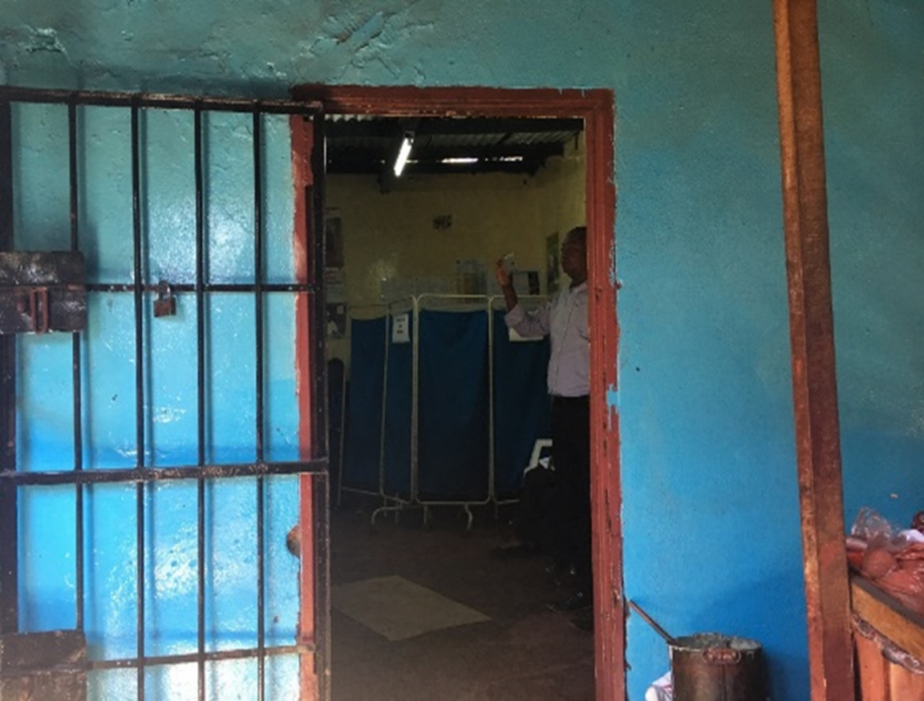
Faith-engaged community posts led to >1200% increases in case-finding for HIV, with high yields in contacts
We can leverage this model for COVID-19
Circle of Hope Community Posts Introduced
PEPFAR Solutions: Circle of Hope
Notes:
We worked with CDC to develop a faith-engaged community post model in Zambia, to help us improve case-finding and contact tracing for HIV. Using this model led to over 1200% increase in case finding, with high identification and yields in contacts. This model was so successful, that the Ministry of Health has expanded it to the whole country. We will leverage this model for success in the COVID-19 response.

Slide 3
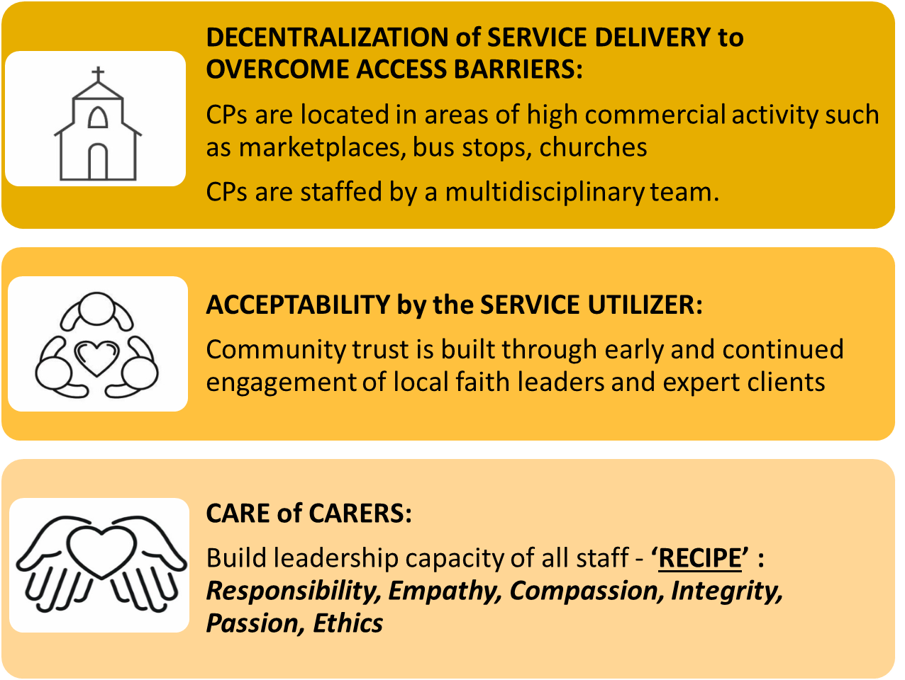



3-Pronged Approach to COH Success – for HIV before and during COVID-19
Notes:
The RECIPE that explains our robust success is simple-- it has all about how we treat the CLIENT – we treat each person with (read slide and please say one sentence ONLY about each element)

Slide 4
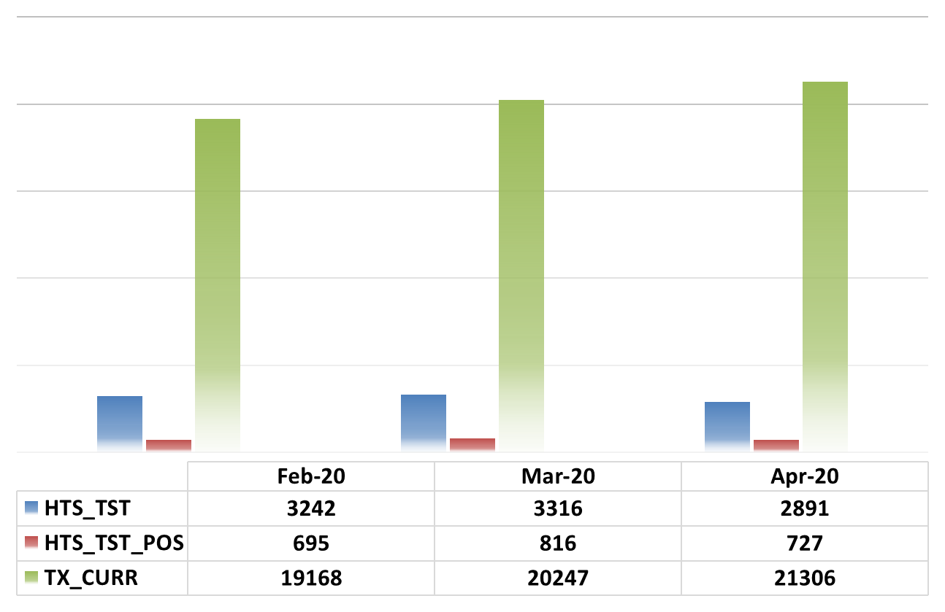
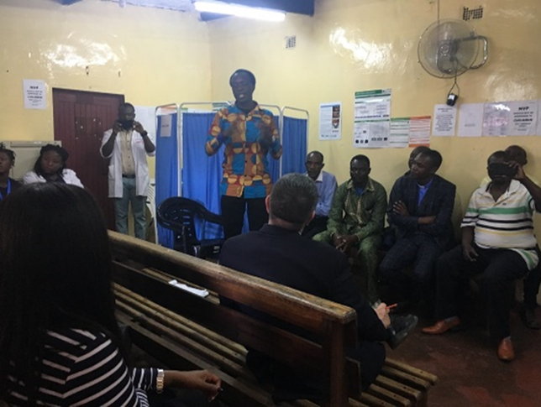
Faith-engaged community posts maintain gains on TX_CURR in context of COVID-19, Feb, Mar, Apr 2020
Faith Leaders have:
      Trust
      Access
Notes:
We worked with CDC to develop a faith-engaged community post model in Zambia, to help us improve case-finding and contact tracing for HIV. Using this model led to over 1200% increase in case finding, with high identification and yields in contacts. This model was so successful, that the Ministry of Health has expanded it to the whole country. We will leverage this model for success in the COVID-19 response.

Slide 5
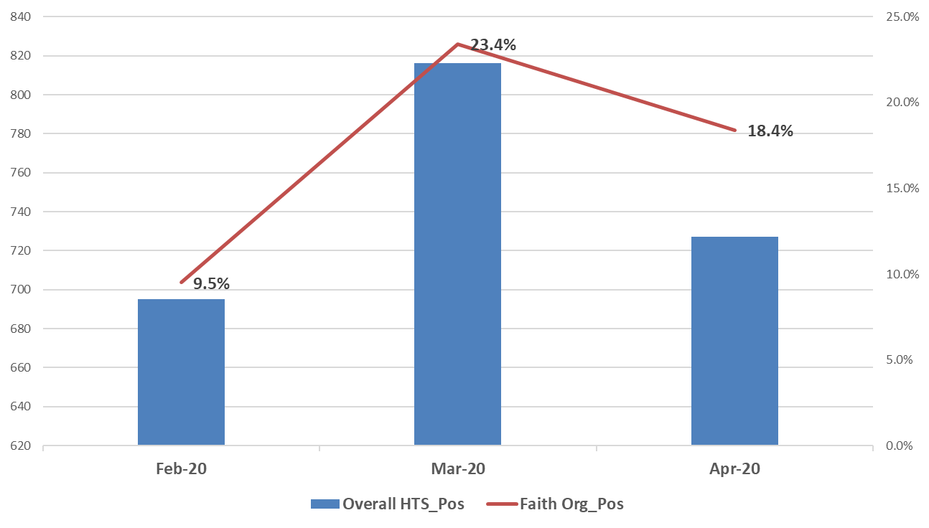

Faith-engaged community posts’ contribution to HTS_POS amidst COVID-19
Notes:
We worked with CDC to develop a faith-engaged community post model in Zambia, to help us improve case-finding and contact tracing for HIV. Using this model led to over 1200% increase in case finding, with high identification and yields in contacts. This model was so successful, that the Ministry of Health has expanded it to the whole country. We will leverage this model for success in the COVID-19 response.

Slide 6
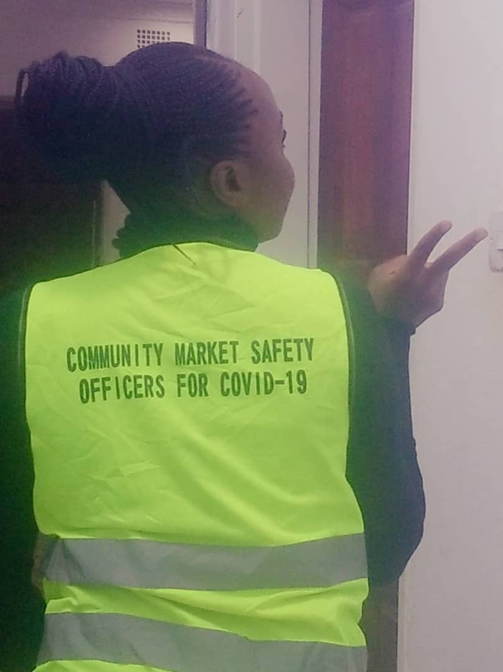
Faith Champions go daily from community posts into their own communities, to Maintain 95-95-95 AND address COVID-19
  Messages of Hope
  Case-finding
  Linkage/Safe care
  Indexing/ Tracing
  Contacts
  Refer for food and
  violence risks
Notes:
We engage our FAITH CHAMPIONS, who go daily from community posts into their own communities, and they have added the COVID-19 SAFER strategies into their HIV goals. For COVID-19, we are implementing programs that review the goals every morning in mitigation, case finding, safe care, and contact tracing.

Slide 7
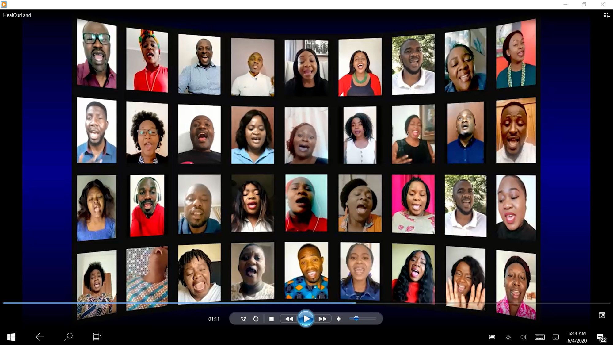
Messages of Hope – WhatsApp, Facebook live, Youtube, with Music therapy
Notes:
We complement all our activities by engaging local faith communities to help us keep KEEP HOPE ALIVE! For anyone suffering from COVID-19 or in quarantine; here is an example of a beautiful video to the song ‘Heal our Land,’ that we our faith leaders and members might send to someone who is physically distancing, to keep that person and their family socially connected!!!
Thank you!

