Slide 1
Monitoring & Evaluation for FBOs:
An Introduction
May 18th, 2022
Shabbir Argaw

Slide 2
Learning objectives
By the end of this webinar you should be able to:
Describe the basic purpose and scope of M&E
Differentiate between monitoring functions and evaluation functions
List various program components and their relationship to M&E
State the elements of a basic M&E plan
Identify the most important criteria for the selection of indicators and data sources
Distinguish between different measurement methods
Describe the elements of data quality

Slide 3
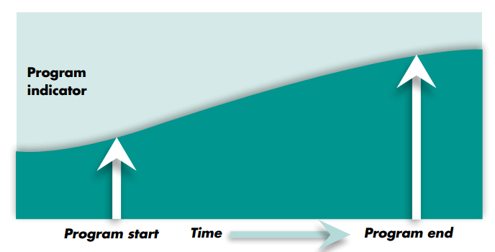
Key terminologies: Monitoring
Monitoring is the continual and systematic collection of routine data to measure progress towards program objectives.
Example questions that can be answered through monitoring data:
What is the program doing?
Is the program reaching the intended population?
Has the quality of services improved?
Has capacity increased?

Slide 4
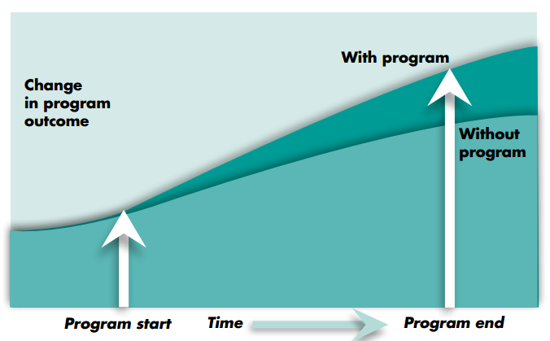
Key terminologies: Evaluation
Evaluation is the periodic, systematic assessment of the design, implementation and results of an ongoing or completed project.
Evaluation can answer:
What are the needs of the intended population?
What barriers do the intended population face?
Was the program implemented as intended?
Can improved outcomes be attributed to program efforts?
Notes:
M&E complements other data collection efforts (e.g., academic research, disease surveillance, operations research).

Slide 5
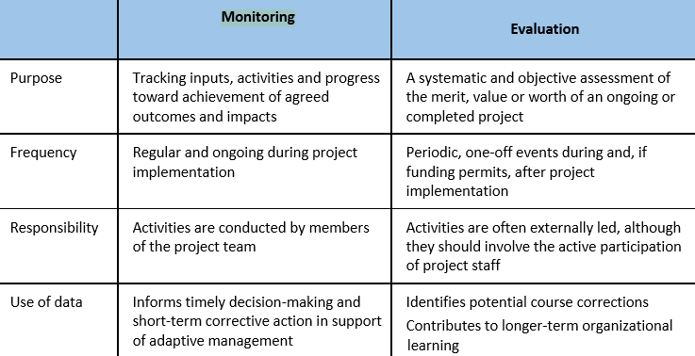
Differences between the M and the E

Slide 6
Why undertake M&E?
M&E ensures that activities are happening, outputs are being produced, and outcomes are being tracked interventions/programs progress, vis-a-vis the intended targets.
M&E data are also a reporting requirement of most donors; results convince donors that their investments have been worthwhile or that alternative approaches should be considered.
Looking at data critically helps organizations make informed decisions regarding program operations and services based on objective evidence.

Slide 7
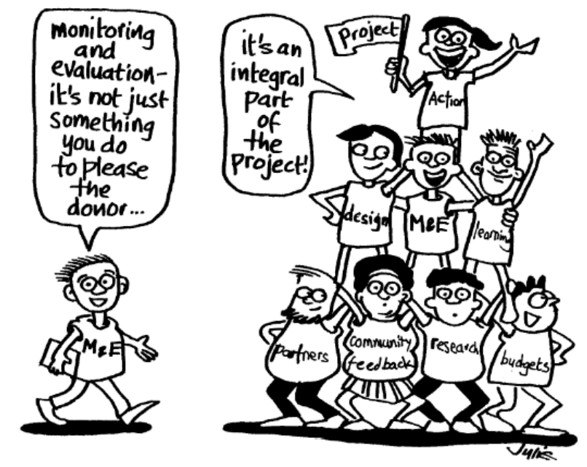

Slide 8
Linking program design to M&E
Ideally, M&E should be planned at the design stage of a program. However, it is never too late to think about M&E because it is critical to a program’s success!
M&E should be aligned to the “pathway of change” that is articulated at the design stage. This is frequently communicated through a framework or illustration of the change resulting from the intervention. These can include:
A theory of change
A results framework
A logical framework
A logic model

Slide 9
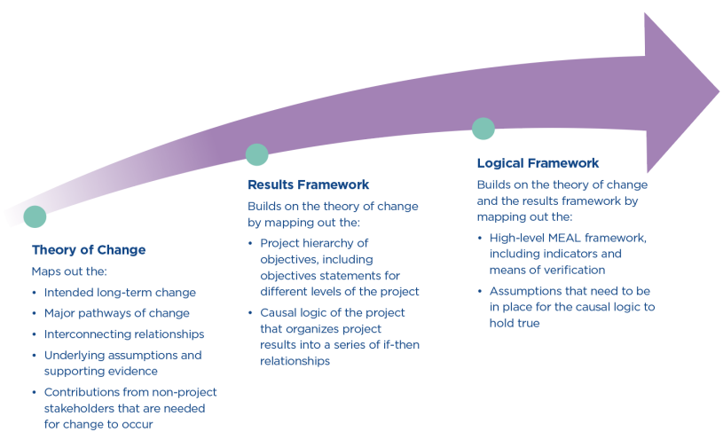
Understanding a theory of change vs. a results framework vs. a logical framework

Slide 10
What might a theory of change look like for FCI Priority 1?
Goal: Rapidly increase the proportion of men and children living with HIV who know their status, are linked to care and have viral load suppression
Objectives:
To achieve transformation in perceptions about HIV by replacing old messages of fear and death with new messages of hope and life
To increase targeted case-finding, linkage, and retention for men and children living with HIV, by leveraging the specific and intimate social and organizational networks within faith communities
To decrease loss to follow up by decreasing stigma and non-adherence associated with faith healing
To develop the capacity of FBOs and Faith Communities to monitor and evaluate the impact of program activities using standardized PEPFAR indicators (MER and DATIM narrative indicators)

Slide 11
Understanding a logic model
Logic models consist of five key components:
Program Component | Definition
Inputs | The key resources that you need to undertake your activities
Activities | The activities and processes you undertake so that you achieve your desired outputs
Outputs | The immediate and direct result of your activities that contribute to the outcomes you seek
Outcomes | The results that occur both immediately and some time after the activities are completed
Impact | The long-term results of one or more programs over time

Slide 12
What might a logic model look like for FCI Priority 1?
Inputs
Activities
Outputs
Impact
Funding
Mapping out social and organizational networks within faith communities
Disseminating sermons and messages of hope through social media platforms
Conducting HIV testing campaigns
Increased demand for HIV testing
Changed attitudes and behaviors about HIV among caregivers and men
Increased percentage of HIV-positive men and children retained
Outcomes
5,000 congregants reached with HIV testing messages
Equipment and materials (e.g., test kits, medicines, messages of hope, training modules, etc.)
FBO staff and faith leaders’ time
Organizing community educational events to educate and destigmatize HIV
100 sermons and messages disseminated on 5 social media platforms
1,000 men tested for HIV
500 children tested for HIV
40 FBO staff trained in M&E
Training FBO staff on M&E principles and methodologies
Increased percentage of children and men know their HIV status
Increased number of HIV-positive men and children linked to treatment
Decreased HIV transmission
Increased percentage of HIV-positive men and children virally suppressed
Decreased HIV morbidity and mortality

Slide 13
What are indicators?
An indicator is a metric that provides information to monitor performance, measure achievements, and determine accountability.
Indicators can be quantitative or qualitative.
It measures whether and by how much a program is changing and is directly related to the program’s pathway of change.
Indicators can be defined at each section of the logic model (e.g., input, activity, output, outcome or impact levels)
Some considerations when choosing indicators are availability of data, costs of collecting the data, technical skills to collect the data and availability of appropriate systems to collect/manage the data.

Slide 14
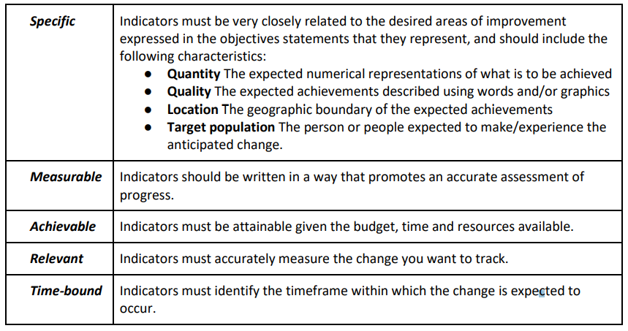
SMART indicators

Slide 15
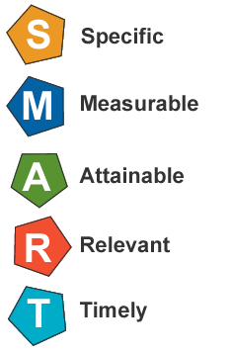
How can we create a SMART indicator for this outcome from our logic model?
Increased number
of HIV-positive men
and children linked
to treatment

Slide 16
Data sources
Data sources are where data for M&E can be derived from.
As such data sources can take multiple forms: HIV testing registers at health facilities, pastors and deacons who are interviewed, logbooks located within labs, etc.
Data can come from several levels: client, program, service environment, population, and geographic levels.
Data sources can include primary (new data that the project collects directly) or secondary (published or unpublished data already in existence) data.

Slide 17
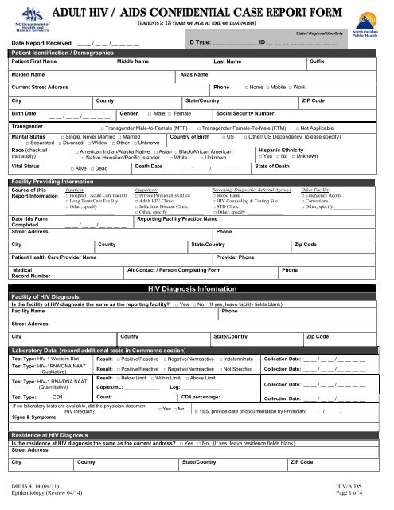
Methods for collecting data for M&E
Measurement methods identify how the project will gather the data to track the indicators.
Quantitative methods collect data that can be counted and subjected to statistical analysis.
Qualitative methods capture participants’ experiences using words, pictures and stories. This qualitative data is collected through prompting questions that trigger reflection, ideas and discussion. Qualitative data are analyzed by identifying themes, topics and keywords.

Slide 18
Five data quality dimensions
Validity: Data are valid when they accurately represent what you intend to measure. In other words, the data you collect helps you measure the indicators you have chosen. When designing your collection methods, make sure they will collect data that will help you measure the indicators outlined in your PMP. Also, the mix of collection methods should meet your needs for triangulation.
Reliability: Data are reliable when the collection methods used are stable and consistent. Reliable data are collected by using tools such as questionnaires that can be implemented in the same way multiple times. In practice, this means that if you use the same questionnaire to ask the same person the same questions and nothing else has changed, you should get the same answer. Consider this factor when you are designing your discussion guides and questionnaires for focus groups and interviews.
Precision: Data are precise when they have a level of detail that gives you an accurate picture of what is happening and enables you to make good decisions. For example, precise data allow you to compare results between men and women, if this is important for your project. When designing your data collection tools, make sure any subgroups you have identified are incorporated into the design. Accordingly, precise data are collected using appropriate sampling methods, which are described in detail below.
Integrity: Data have integrity when they are accurate. Data should be free of the kinds of errors that occur, consciously or unconsciously, when people collect and manage data. Errors can enter your data when, for example, the questionnaire is implemented incorrectly or the data are not properly entered into the database. Following the guidance outlined below on the design and implementation of collection tools and the management of the data you collect will increase the integrity of your data.
Timeliness: Timely data should be available when you need it for learning that informs decisions and for communication purposes. Data are not useful to you when they arrive too late to inform these processes. This factor plays a significant role in your planning for data collection, which is the reason for the column in the PMP on timing. Design your data collection efforts to coincide with when you need to make decisions, and report to stakeholders. Timeliness should also be factored into the design and implementation of your tools. You want to make sure that your design is as efficient as possible and only collects the data that you absolutely must collect.

Slide 19
Data cleaning methods to ensure high data quality
Conducting quality checks: Randomly selecting and comparing raw data to the electronically entered data to check for data-entry and coding errors. Teams that use digital devices to collect data can skip this step.
Identifying outliers: Checking whether there are unexpected entries in the data. This could mean that the person entering data does not understand the process and has made a coding error. For example, if a questionnaire asked a question about age, and an age of 110 was entered, you would quickly spot the error, and be able to prevent similar ones.
Removing duplicate entries: Confirming that each data record (questionnaire, form, etc.) has a specific, unique identification number and that no numbers have been repeated in the database.

Slide 20
Data Visualization and Use
Data visualization is the presentation of data in a pictorial or graphical format. It enables one to see data presented visually, so one can identify real-time trends / outliers and gain new insights.
Data use is the scrutiny and review of data to inform action in the form of strategic planning, policymaking, program planning and management, advocacy, or delivering services.

Slide 21
Examples of visualizations: Report cards
Country | Project | HTS_TST | HTS_TST_POS | TX_NEW | TX_CURR | TX_NET_NEW | TX_PVLS
 |  | % of Targets Achieved | % of Targets Achieved | % of Targets Achieved | % of Targets Achieved | % of Targets Achieved | % of Patients Virally Suppressed
Cote d'Ivoire | Djasso | 119% | 53% | 42% | 61% | -12% | 78%
DRC | Kimia | 68% | 97% | 86% | 76% | -25% | 77%
DRC | IHAP | 44% | 90% | 93% | 100% | 98% | 83%
Kenya | ZUIA | 89% | 74% | 70% | 96% | 77% | 86%
Kenya | Timiza | 82% | 71% | 56% | 93% | 39% | 91%
Lesotho | STAR-L | 92% | 42% | 49% | 73% | 5% | 95%
Lesotho | PUSH | 84% | 43% | 47% | 75% | 10% | 94%
Malawi | Pivot 2 | 104% | 60% | 61% | 60% | -21% | 86%
Mozambique | ESCALA | 88% | 54% | 54% | 76% | 53% | 79%
Tanzania | Boresha Afya | 79% | 59% | 64% | 91% | 3% | 87%
Uganda | RHITES-SW | 107% | 93% | 85% | 90% | -15% | 93%

Slide 22
Number of patients tested for HIV
Examples of visualizations: Line charts

Slide 23
Percentage of HIV-positive patients co-infected with Cryptococcal Meningitis and Tuberculosis
Examples of visualizations: Lollipop charts
CM co-infection
TB co-infection

Slide 24
HIV Positivity Yield by Gender and Age
Examples of visualizations: Looking at data split by age and sex

Slide 25
Putting it all together: Developing an M&E Plan
Components of an M&E Plan
An M&E Plan is a document that describes all the activities/ components within an M&E system and serves as the main guide for monitoring a program. It comprises of all of the points we have covered in the previous slides and more.
Results framework
Logic model
Data use
Data quality
Program goals and objectives
Indicators
Data management

Slide 26
Matthew 11:2-5: A biblical example of M&E
When John, who was in prison, heard about the works of Christ, he sent his disciples to ask him, “Are you he who comes, or should we look for another?” Jesus replied, “Go and tell John the things which you hear and see: The blind receive their sight, the lame walk, the lepers are cleansed, the deaf hear, the dead are raised, and the good news is proclaimed to the poor.”

Slide 27
Matthew 11:2-5: M&E is nothing new!
In our example…..
Who collected the data?
What data collection method(s) did they use?
Did they collect primary or secondary data?
What indicators were monitored to assess change?
Were they monitoring inputs, activities, outputs or outcomes?
Who was the main stakeholder interested in these data?
Notes:
Who collected the data? -- the two disciples
What data collection method did they use? – observation and counting of actual beneficiaries
Did they collect primary or secondary data? – primary (for the purpose of answering the question to John)
What indicators were monitored to assess change? -- # of deaf who heard; # of blind who could see; # of lepers cured, etc.
Were they monitoring inputs, activities, outputs or outcomes? – inputs – Jesus’s Devine powers; activities - Jesus’s interventions, outputs/outcomes – results of Jesus’s work
Who was the main stakeholder interested in these data? – John, Jesus, all those who benefitted out of Jesus’s interventions, the 2 disciples who were the messengers for John and Jesus!

Slide 28
Thank you!

