Slide 1
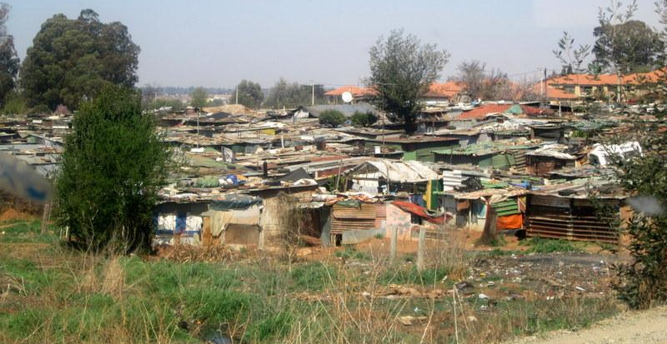
Hope and challenges in working within informal settlements
Martin Kapenda
Zambia

Slide 2
The informal settlement is a site of multilayered crisis

Slide 3
The Status of Informal Settlements
In informal settlements the combination of population density and limited infrastructure pauses a big challenge:
Residents rely on daily earnings;
Communities often have highly inadequate access to water, sanitation, and hygiene (WASH) and other vital services;
It is hard to socially distance;
Majority of residents of informal settlements often work in places which have implications for the virus’ spread.

Slide 4
Its hard to protect residents of informal settlements
Handwashing, disinfecting surfaces, physical distancing and quarantine for those infected
– essential elements in COVID-19 prevention –
are often impossible.

Slide 5
COVID –19 is simply adding another layer to the multi layered crisis at community level

Slide 6
COVID-19 is not just a healthy issue
It has revealed different layers of social challenges in informal settlements –
There increased vulnerabilities for women and children
Most men are alleged to have deserted their responsibility that has scaled up gender-based violence
Business has come to a standstill and the women are using their incomes and saving to buy household items
an increase in domestic violence cases since the COVID-19 outbreak
Lockdowns are increasing the risk of intimate partner violence

Slide 7
The Biggest Challenge…………
People distrust Government information on COVID 19

Slide 8
But people trust their faith leaders… so there is hope working in informal settlements

Slide 9
Hope in Informal settlements
There are local community structures which are in place and are used to support community initiatives
Faith leaders usually coordinate education and training measures in times of emergencies and provide required services
There is a pool of volunteers mainly from faith groups who are well versed in community-led development or disaster relief;
Many faith groups in the community have vibrant WhatsApp or Facebook groups which can be used as a channel for mobilisation during an emergency..

Slide 10
Faith leaders can inspire change by:
Inspiring communities towards the common good
Providing the right information
Networking with outsiders

Slide 11
As a Faith You need to speak up for the victims of COVID-19 in informal Settlements
Women + children in abusive relationship are exposed to more violence;
Women during lockdowns may have less contact with family and friends who may provide support and protection from violence.
Women are continuing to bear the brunt of increased care work during this pandemic
Disruption of livelihoods and ability to earn a living will put more women at greater risk for experiencing economic abuse
COVID 19 restrictions are being abused by perpetrators to exercise power and control over their partners
Perpetrators are taking advantage of COVID-19 to control and stigmatise women and children

Slide 12
The increased violence that women and children are facing during the current COVID-19 crisis cannot be ignored –
Faith leaders can raise they voices to change the conversation and course of action for women and children at risk of violence.

Slide 13
Thank You

