Slide 1
FAITH AND COMMUNITY INITIATIVE (FCI) HIV Testing Services – Coptic’s Experience
Dr. Sherry Eskander
28th October 2020
FCI New Foundations of Hope Webinar

Slide 2
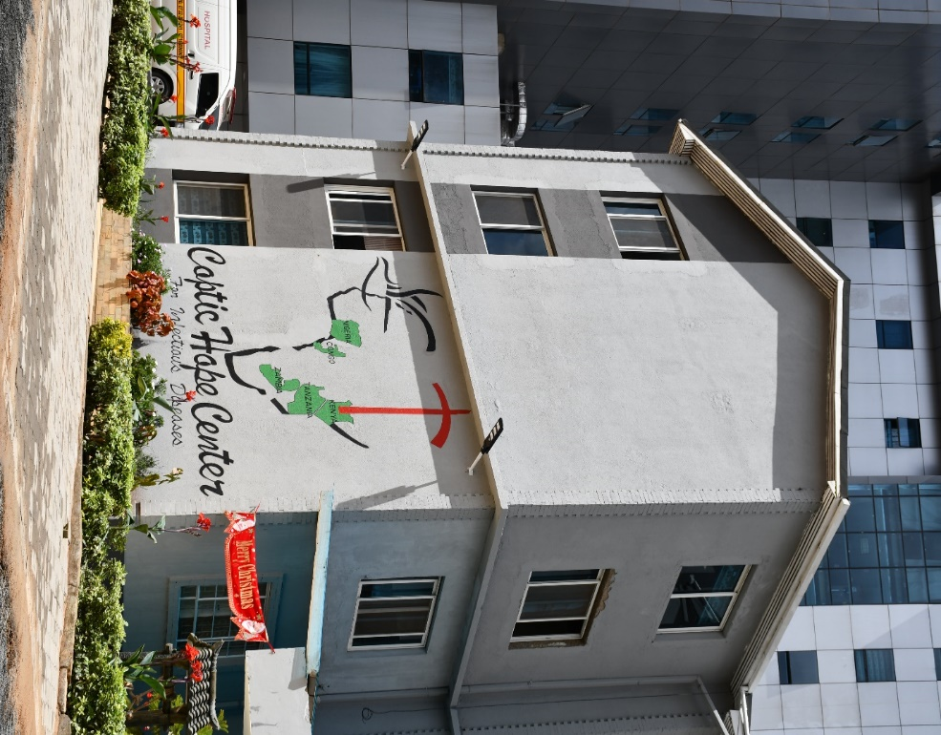
Introduction
Coptic Orthodox Church: the oldest church in Africa, currently has over 20 million believers around the world.
Coptic Hope Program: the epitome of the Coptic Mission’s work to address the impact of HIV&AIDS on the lives of the Kenyan communities.
Three facilities: 2 in Nairobi 1 in Western Kenya and other adopted satellite clinics; more than 30,000 clients ever enrolled in care and treatment.
Church Network: over 50 churches in total in Kenya.

Slide 3
Coptic FCI Footsteps
Works through church & community networks for targeted testing and linkages
Four highest-prevalence, priority counties in Kenya: Nairobi 6.1%, Kisumu 16.3%, Siaya 21% and Vihiga 5.4%.*
Communities reached with essential messaging and services through social networks
FCI funding allows Coptic to boost experience, efforts and achievements in HIV prevention, care and treatment
Great milestones have been achieved so far through FCI
*Adult prevalence, Kenya HIV estimates report 2018

Slide 4
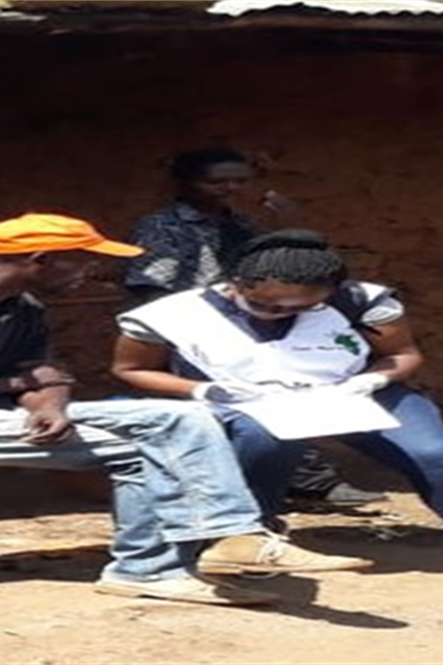
HTS Experience in FCI
Coptic leveraged its experience to work with the Clergy and church platforms to:
Engage with indigenous churches with strong affiliation to faith healing
Sensitize and disseminate key HIV prevention, care and treatment messages
Identify and train community ambassadors of change among the community leaders
Map out hot-spots that will help in yielding of new positives among the communities
Create demand for targeted HTS including self-testing
Mobilize congregants through ambassadors of change for uptake of HTS
Link newly tested HIV positive clients to care and treatment

Slide 5
Process
Religious leaders identified and trained as peer leaders
HTS providers attached to each religious leader
Peer leaders mobilize congregants for HTS during mass church services
Peer leaders screen households for HTS and mark the targeted households
Peer leaders lead HTS providers to the targeted households for HTS
Using RAST, HTS providers screen the households for eligibility and offer HTS through HIVSTK or rapid testing where appropriate
Real time linkages done for those testing HIV positive

Slide 6
HTS Achievements in FCI
Indicator | Target | Oct’19 -Mar’20 | Apr’20 -Sep’20 | % of Target
Total tested | 1,000 | 2,242 | 3,126 | 536%
# Positive | 0 | 185 | 399 | -
HIVST | 2,580 | 525 | 1,673 | 85%
#Positive by HIVST | 0 | 20 | 39 | -

Slide 7
High Positivity Yields due to:
Targeted community mapping including indigenous churches, alcohol dens and index testing
Use of RAST: asking questions in the tool to every client who is not HIV positive to assess their risk of contracting HIV
Targeted testing for people who are at risk but do not present themselves as at risk within the matrix of the faith community
Ambassadors of change who live in the community and lead HTS providers to targeted households/individuals
Staff motivation through tokens of appreciation and Employee of the Month
Healthy competitions amongst the peer leaders, ambassadors of change and HTS providers
Weekly debriefing sessions every Friday

Slide 8
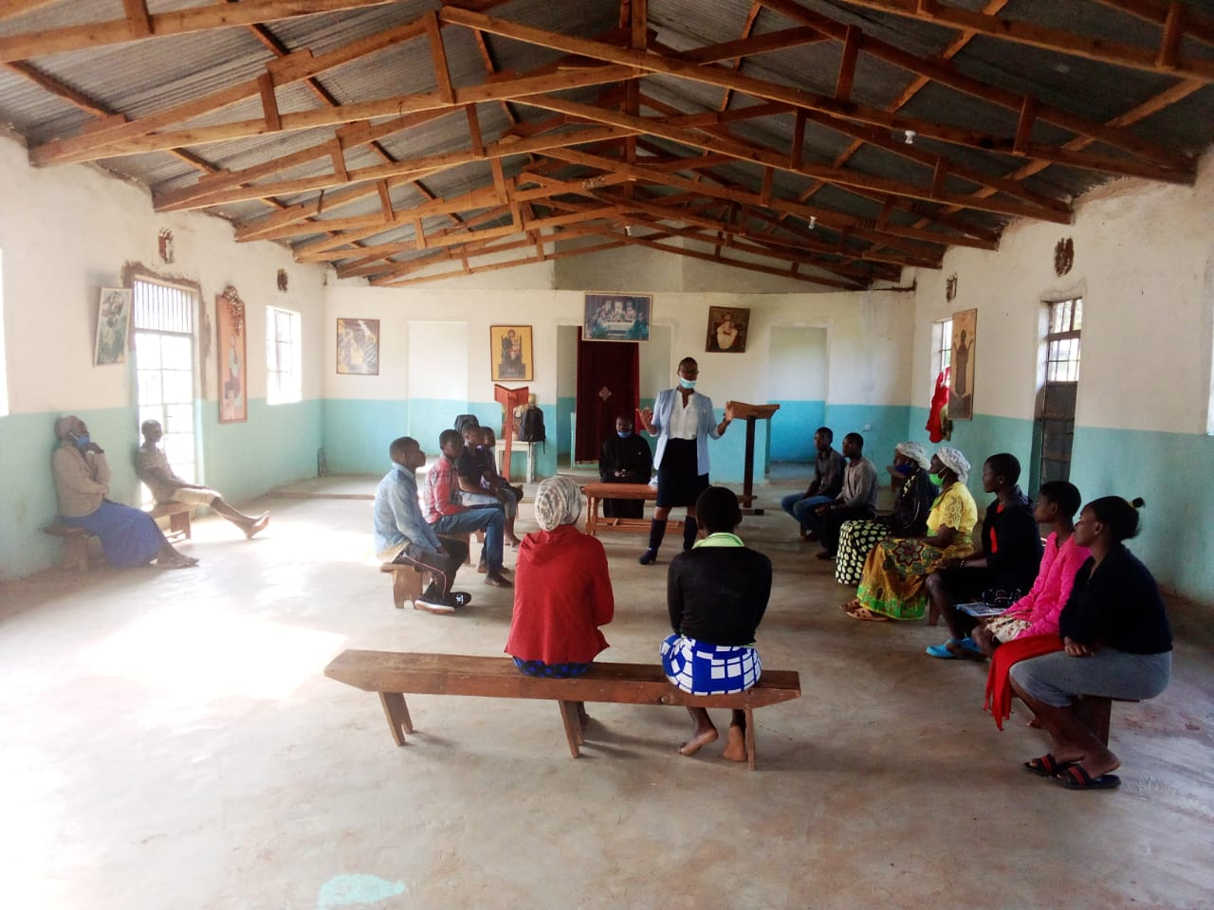
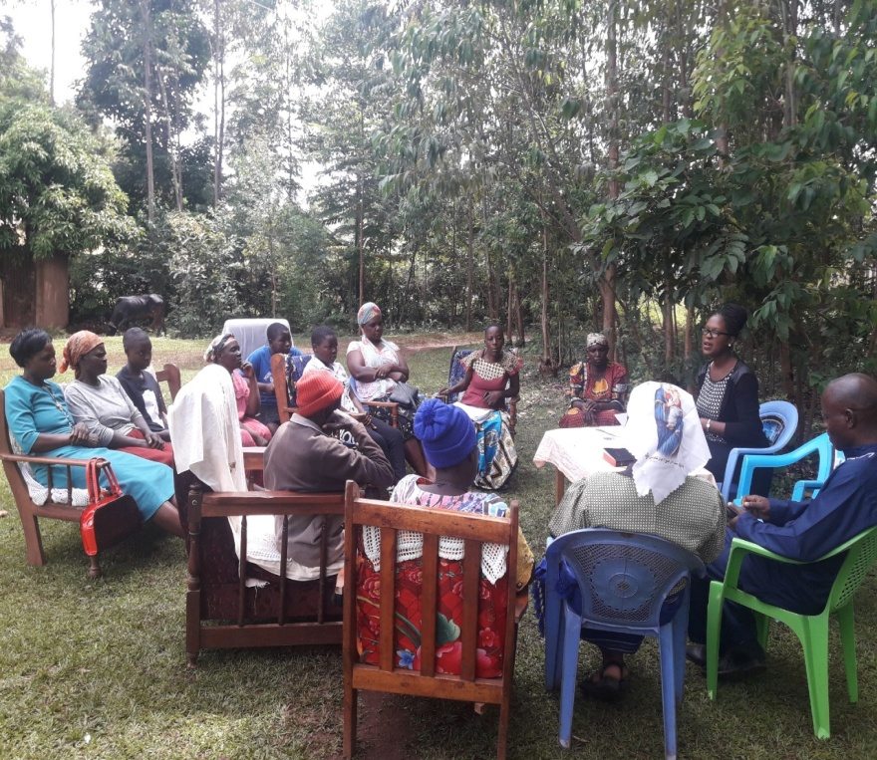
Promising Practices
Linking faith leaders with counselors, to maximize every opportunity for testing
Continuous support/empowerment of faith leaders
Assisted self-testing and immediate linkages for confirmatory tests, care and treatment
Training of faith leaders on RAST
enable them to guide HTS counselors to the right targets
enable them to note exposure indicators during their one on one discipling/confession sessions with congregants, and link them to services

Slide 9
Success Stories
Congregants disclosed HIV-positive status to their pastors after integrated sermons – leading to aPNS
Faith leaders confronted issues on faith healing leading to non-adherence – important for 1st time testers
Family testing among congregants especially during this COVID-19 times
Review of non-biblical doctrines by faith leaders from the information acquired during the sensitizations – creating demand for HTS
A lot of demand for sensitizations after the realization of the knowledge gap among faith leaders

Slide 10
Community Testing

Slide 11
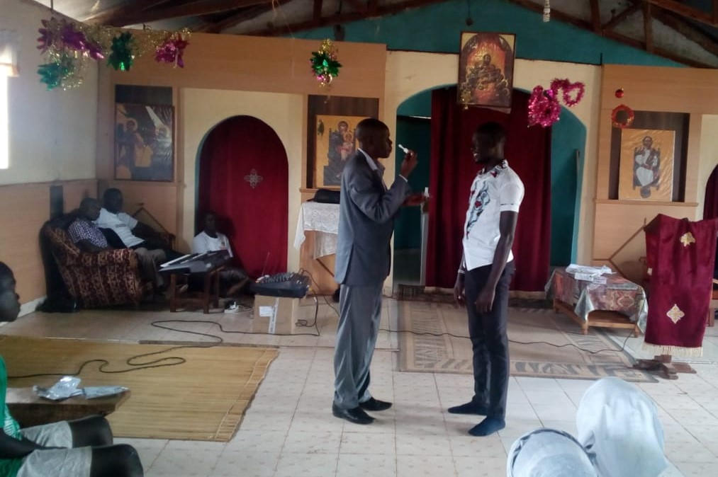
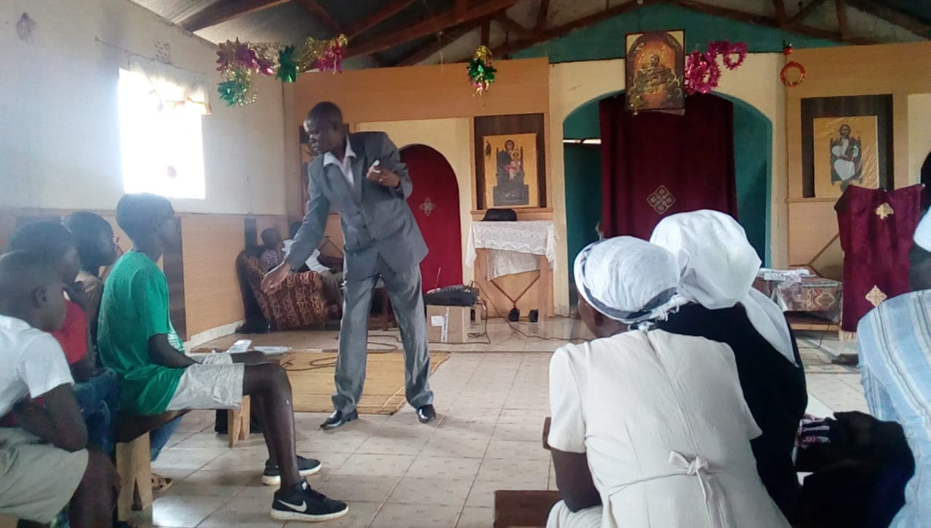
Demonstration of HIV Self-testing

